Slide 1
Sound Waves and Beats with Vernier Sensors
Brian Cain

Slide 2
Reasoning behind the Subject
Music is popular among students
Many students play instruments already
Notes:
Sound waves can be related to music, and thus might be easier to understand and explain the concept of a wave through sound, rather than light or any other way

Slide 3
Waves
What is a wave?
What types of waves exist?
Notes:
Wave: A way for energy to travel from one place to another
Types of Waves: Light, Sound....???

Slide 4
Sound Wave
What about a sound wave?
Energy produced by vibration travels through the sound pressure midpoint in the room and is picked up with sensors like microphones or ears

Slide 5
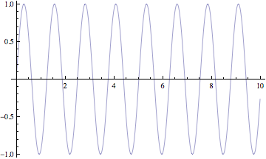
Take a Guess, Rate the Wave A
High Pitch, Medium Pitch, or Low Pitch?

Slide 6
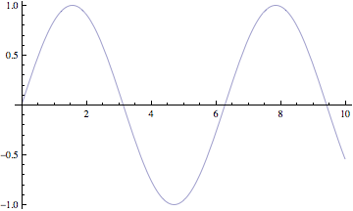
Take a Guess, Rate the Wave B
High Pitch, Medium Pitch, or Low Pitch?

Slide 7
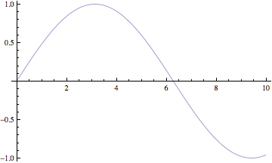
Take a Guess, Rate the Wave C
High Pitch, Medium Pitch, or Low Pitch?

Slide 8
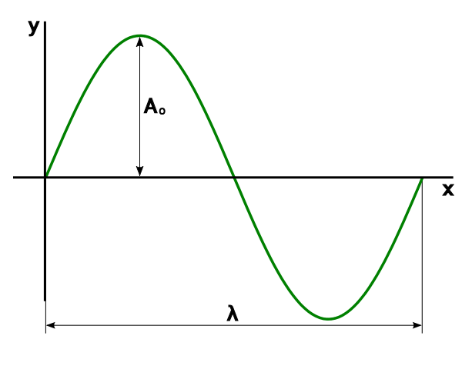
Properties of Waves: Period
The period of a wave is the time it takes for one complete cycle of repetition
The period
determines the
pitch of a sound
wave
Notes:
In this case, the lambda is the period of this sine wave
Correct Answer: A, B, C for highest to lowest

Slide 9
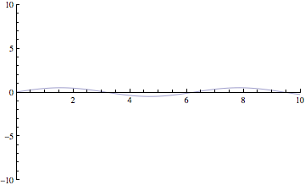
Take a Guess, Rate the Wave X
Loud, Medium, or Quiet?

Slide 10
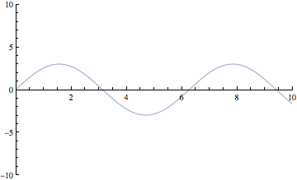
Take a Guess, Rate the Wave Y
Loud, Medium, or Quiet?

Slide 11
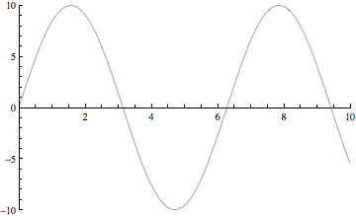
Take a Guess, Rate the Wave Z
Loud, Medium, or Quiet?

Slide 12
Properties of Waves: Amplitude
Amplitude is defined as the maximum variation above or below the pressure midpoint
This is closely
related to loudness
Notes:
A second property of sound is the amplitude. As the pressure varies, it goes above and below the average pressure in the room. The maximum variation above or below the pressure mid-point is called the amplitude. The amplitude of a sound is closely related to its loudness.
Correct Answer: Z, Y, X Loud to soft

Slide 13
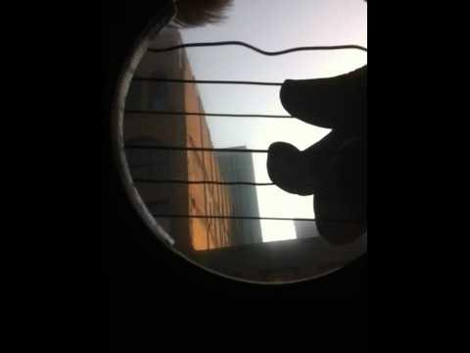
Waves in Action
Notes:
Warning: This isn't the actual waves that the strings are making, the camera is not catching every frame, so it looks like this. However, it is still an interesting demo of the strings.

Slide 14
Properties of Waves: Two Waves
What happens when multiple waves travel through the air? Such as when a chord is made on a guitar?
Well...this happens.....
Cool Waves!
This is known as beat waves, when two different frequencies collide

Slide 15
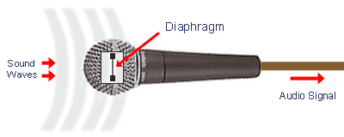
Microphones
Microphones are a sensor of sound waves
How do they work?
Sound waves travel from a source through the air
A sensor called a diaphragm vibrates to the same frequency of the sound that is gathered by the microphone
That frequency produced by the diaphragm is translated into a digital signal and sent to a computer
Notes:
This is a lot like how a Human ear works.

Slide 16
Procedure : Simple Waves
Produce a sound with the instrument, and record it using the microphone and the sensor
Count the cycles of the wave
Determine the period by taking the time interval t, and dividing it by the number of cycles
Calculate the frequency (f = # of cycles / t)

Slide 17
Procedure : Simple Waves
5. Determine amplitude (Remember, this is the average distance between the peak of the wave and the pressure midpoint, A_{o})
6. Repeat again for second tone

Slide 18
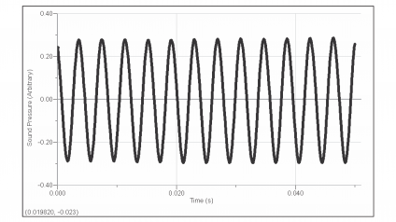
Graph from Vernier Sensor

Slide 19
Analysis
A sound wave can be modeled by this simple equation on a graph
y = A * sin(B*t + C) + D
Let's break down this equation...
Notes:
This is the equation that a computer most likely uses

Slide 20
y = A * sin(B*t + C) + D
A : Amplitude of the wave
B : 2*π*f, f being frequency
t : Time, or the horizontal axis
C : Shifts the wave left or right
D : Shifts the wave up or down

Slide 21
Analysis
In this part, you can use the sensor equipment to do a "curve fit", which can estimate frequency and amplitude of the wave.
Students can do this at the end to compare their own results with the devices

Slide 22
References
Microphone Image: http://www.mediacollege.com/audio/microphones/how-microphones-work.html
Vernier Sensor Lab: http://www.vernier.com/experiments/pwv/32/sound_waves_and_beats/
http://www.acs.psu.edu/drussell/demos.html

Slide 23
Outside Software Used
Mathematica to generate wave graphics

