Slide 1
Citizen Science with the Zooniverse

Slide 2
What is Citizen Science?
Citizen science is science that any ordinary citizen can help with
Usually it involves citizens working with professional scientists
Examples
Medical research
Medication testing
Human Behavior research
Giving computer to complex Science calculations
Helping classify data (ex. Zooniverse)
Notes:
- Talk a little bit about each example, enough to give an general idea of what it is. Around 1 minute for each example should be good.
- Medical research is when doctors test out new medical treatments on people who are sick and volunteer to be test subjects, such as trying a new way to fix a broken leg that will make it heal faster.
- Medication testing is where people are paid to test medications for things such as high cholesterol or heartburn. To help them relate it to their daily lives, ask the students if they have seen those drug commercials where they have a long list of side effects.
- Human behavior research is what Psychologist, Sociologists, and others do to see how people behave in certain situations. For example, Psychologists might pay people to be placed in a stressful environment so that the Psychologists can study the negative effects of stress.
- For giving your computer to complex scientific calculations, you can talk about SETI at home (http://setiathome.berkeley.edu/), which people can download on their computers to have their computer process SETI data when the computer is not being used.
- For helping classify data, mention Zooniverse, and say that it will be demonstrated next. You shouldn't explain it yet.

Slide 3
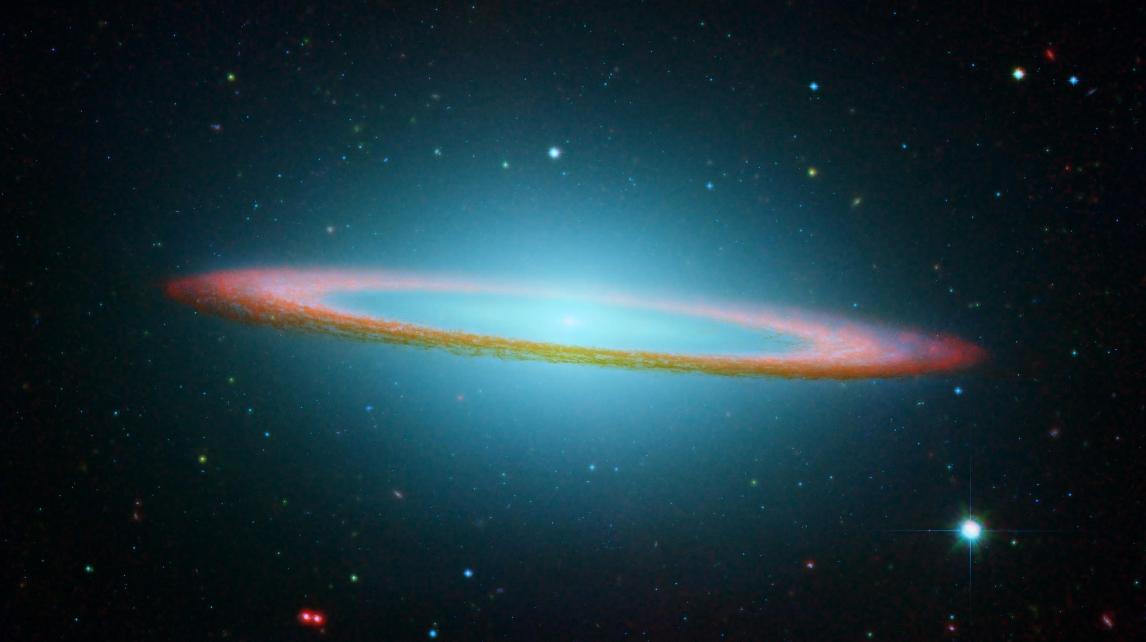
Interactive Activity
Help me identify some Galaxies at Galaxy Zoo
Notes:
- Click the link to go the Galaxy website.
- Once there, click "Take part" and then "Begin classifying"
- When a Galaxy appears for you to classify, ask the students for input on how to classify it.
- Be sure to show them that they can use the Help button to learn more about how they should classify the different types of galaxies.
- Explain to them that multiple people look at each of these galaxies so if a mistake is made in classification it is not a problem.
- Try to get consensus or at least of a majority vote from the students on how to classify the galaxy.
- Answer all the questions about classifying the galaxy until its classification is complete. Be sure to get input from the students at each step.

Slide 4
History of the Zooniverse
Started in 2007 with Galaxy Zoo.
Galaxy Zoo was so successful that they expanded the idea into the Zooniverse.
The Citizen Science Alliance (CSA) develops and maintains the Zooniverse.
The CSA works with partners such as universities to create Zooniverse new projects.
Zooniverse has over 800,000 people helping scientists to classify all kinds of things
Notes:
-Show the short video in "Started in 2007"

Slide 5
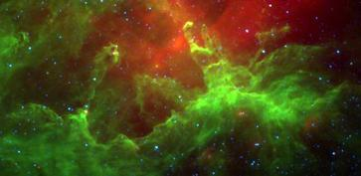
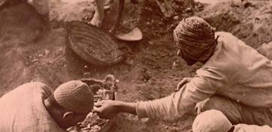
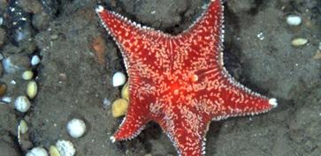
What is Zooniverse?
Average citizens help science
Projects on astronomy, climate science, marine biology, and papyrology
Humans > computers at some tasks
Notes:
- Papyrology is basically the study of ancient texts/books.
- Humans are better than computers at tasks such as image and sound recognition.

Slide 6
Demonstrations
Zooniverse Main Page
Planet 4
Singing Whales
Study the Lives of Ancient Greeks
Seafloor Explorer
Notes:
- Show the students a few of the available Zooniverse projects. You may need to demonstrate different projects than the ones listed above. Projects are added and removed frequently from the Zooniverse website.
- For each one, briefly show how to do it and briefly show the page with the science behind it. If possible, have the students give you suggestions on how to do the classifications. If working with high schoolers, explain more of the science behind the project.

Slide 7
Secret Surprise Quiz!!!
Looking at those examples, can you think of any other scientific research projects that could use Citizen Science?
Notes:
- Try to get at least a few examples from the students if you can.

Slide 8
Questions For Me So Far?
????

Slide 9
We Will Discuss About Your Thoughts At the End

Slide 10
Let's Try It!
www.zooniverse.org
Notes:
-Have the students try whichever Zooniverse projects that look interesting to them.
-Try to have at least 20 or 30 minutes for the students to try out the different projects

Slide 11
Review/Discussion
What was your favorite?
What's something interesting your learned?
Can you think of any other scientific research projects that could use Citizen Science?
Other comments about it?
Notes:
Do the review/discussion when there is about 5 or 10 minutes left. Try to get a few students to answer each of the questions.

Slide 12
References
http://www.scientificamerican.com/citizen-science/
https://www.zooniverse.org/assets/projects/hubble/background.jpg
https://www.zooniverse.org/
https://www.zooniverse.org/about
http://www.youtube.com/watch?v=-T9wizyDV8c
http://www.portlandmercury.com/binary/4eee/1249667804-1cat-computer.jpg

