Slide 1
Citizen Science with the Fold-It

Slide 2
What is Citizen Science?
Citizen science is science that any ordinary citizen can help with
Usually it involves citizens working with professional scientists
Like what we did last time with Zooniverse

Slide 3
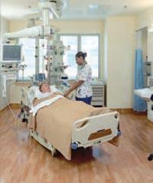
Citizen Science --
Medical Research
Notes:
- Medical research is when doctors test out new medical treatments on people who are sick and volunteer to be test subjects, trying new cancer treatments for the guy in the picture.

Slide 4
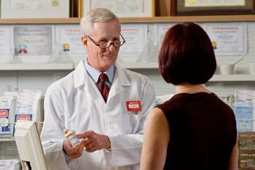
Citizen Science -- Medication Testing
Notes:
- Medication testing is where people are paid to test medications for things such as high cholesterol or heartburn. Point out the scientist and the volunteer citizen in the picture. Mention that all medication is required to go through human testing to make sure it is safe for everyone to use. Before it gets to human testing, it is tested on animals first.

Slide 5
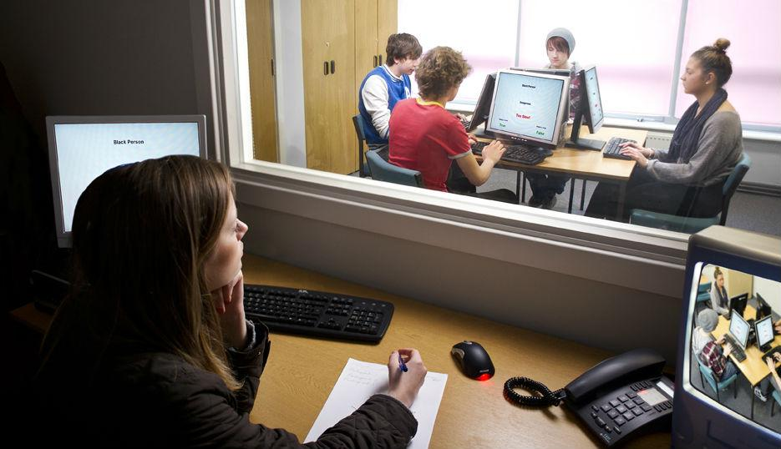
Citizen Science --
Human Behavior Research
Notes:
- Human behavior research is what Psychologist, Sociologists, and others do to see how people behave in certain situations. Point out the Psychologist and the citizens in the picture. For example, Psychologists might pay people to take computerized tests in order to better understand how people learn.

Slide 6
Having Your Computer Help With Science Calculations
Notes:
- For giving your computer to complex scientific calculations, you can talk about SETI at home (http://setiathome.berkeley.edu/), which people can download on their computers to have their computer process SETI data when the computer is not being used. Point out the radio waves in the picture and how they are radio signals from outer space that are coming at our planet from all directions. Ask the students: "How many of you have a radio in your parents' car?" Explain that it is the same idea. Right now, all the radio signals that have been found are just noise, like the noise on the radio when no station is selected.

Slide 7
Helping To Classify Data --
example: Zooniverse
Notes:
- Remind the students of Zooniverse, and some of the activities that they did during the Zooniverse lesson.
- Remind them that average citizens are needed to classify data on Zooniverse because computers and not good at certain types of tasks, such as image and sound recognition.

Slide 8
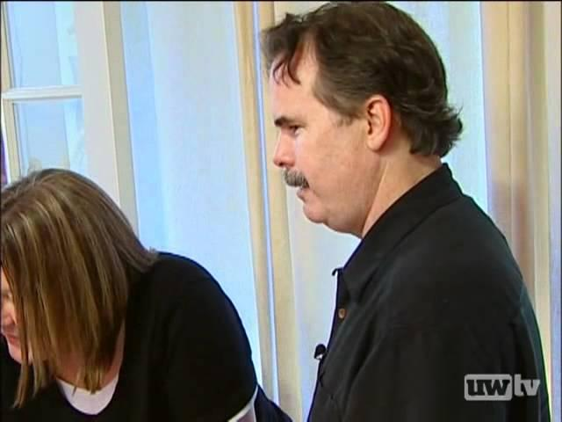
Playing Video Games --
Example: Fold-It

Slide 9
Video Discussion
Proteins are sort of like Lego blocks used to build people, except they fold into strange shapes
Why are people needed for Fold-it? Why can't computers fold the proteins?
What did the Fold-it players help the scientists do?
Notes:
- Try to get at least one student to answer each question.

Slide 10
Fold-It Demonstration
Proteins are complex.
Why the proteins look and behave like this isn't important for now.
Learning how the game of folding the proteins works is important.
Notes:
- Before demonstration Fold-It, explain the points above.
- How protein folding works in detail is far too complex to explain.
- To demonstrate Fold-It, open up Fold-It and go through the first four levels. Explain what you are doing to the students and try to get interactive feedback and suggestions from them.

Slide 11
Questions For Me?
????

Slide 12
We Will Discuss About Your Thoughts At the End

Slide 13
Let's Try It!
Open Fold-it on the flash drive I gave you
Notes:
- Once they get started, wander around answering any questions they have.
- Try to give at least 20 or 30 minutes for them to try Fold-It.

Slide 14
Review/Discussion
Did you have a favorite level?
Was it hard?
Can you think of any other scientific research projects that could use Citizen Science?
Other comments about it?
Notes:
Do the review/discussion when there is about 5 or 10 minutes left. Try to get a few students to answer each of the questions.

Slide 15
References
http://www.nlm.nih.gov/medlineplus/magazine/issues/spring07/images/clinicalpatient04.jpg
http://www.cvscaremarkfyi.com/sites/default/files/styles/blog_img/public/_DSF5121.jpg
http://www.edgehill.ac.uk/psychology/files/2011/08/PsychologyLab.jpg
http://cl.jroo.me/z3/f/Z/a/e/a.baa-Cat-using-laptop.jpg

