Slide 1
NXT Programming
by Paul Cain

Slide 2
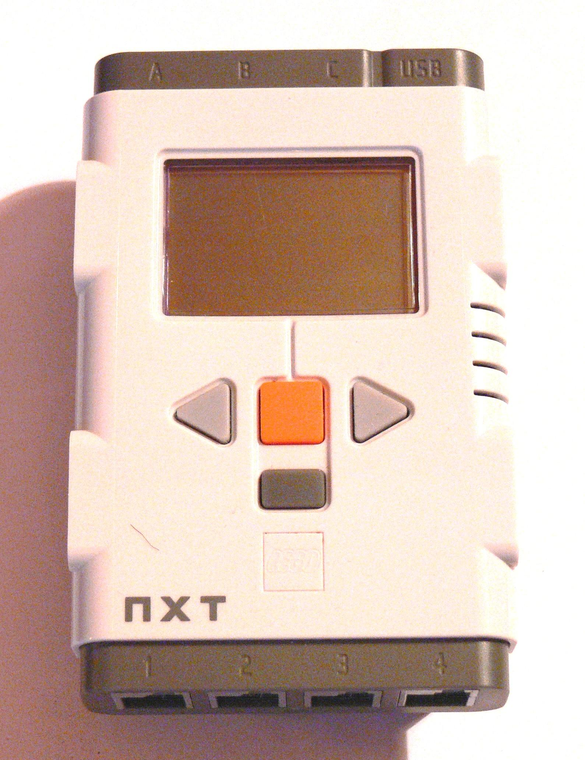
Programming With Lego NXT
Simple Motors
Sensors
Color
Pressure
Ultrasonic
Others depending on kit
Many Homebrew opportunities
http://upload.wikimedia.org/wikipedia/commons/c/cc/Nxt-brique.jpg
Notes:
- Talk about what can be done with NXT programming
- NXTs have simple motors that allow them to move
- The color sensor allows the NXT to determine the color of something it is looking at
- The pressure sensor senses whether it is being pressed
- The ultrasonic sensor is like sonar
- Other kits may come with other sensors
- NXTs have many homebrew opportunities, meaning the NXTs can be customized in ways that the manufacturer did not intend in order to open up new and innovation possibilities. This may void the warranty. Examples will be shown below.

Slide 3
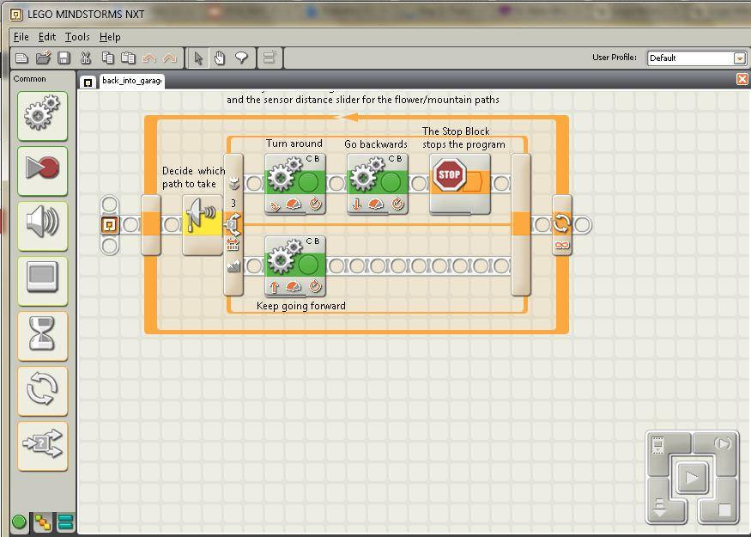
Graphical NXT Programming
Notes:
- This program shows how the robot can back into a garage using the ultrasonic sensor. Briefly, explain this program and what each of the blocks mean. It is not necessary that they understand everything because this is just meant to give them an idea of what graphical NXT programming is like.

Slide 4
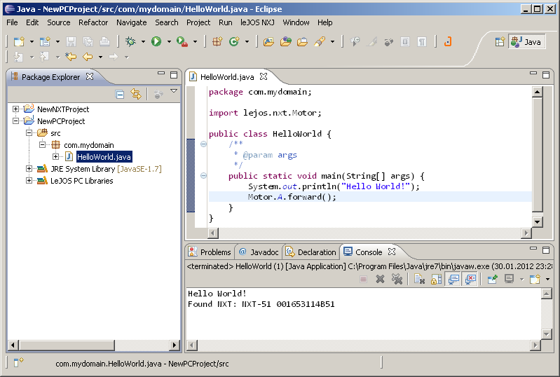
Text-Based NXT Programming
Ada
C++
Objective C
Java
Haskell
Perl
Python
MATLAB
Many others...
http://en.wikipedia.org/wiki/Lego_Mindstorms#Programming_languages_2
http://lejos.sourceforge.net/nxt/nxj/tutorial/Preliminaries/ecl_project_pc11.png
Notes:
- NXTs can also be programmed in many of the traditional text-based languages for those who have the skills. The example on the screen is Java.

Slide 5
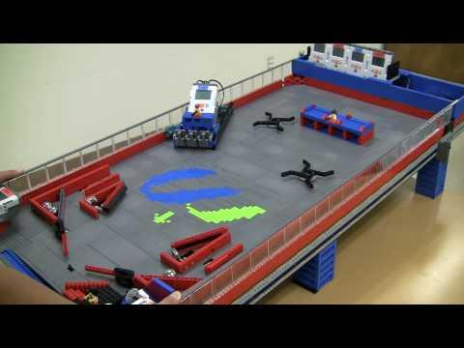
Lego Pinball Machine
http://www.youtube.com/watch?v=hbGTGc3cZnU
Notes:
- This is an example of a clever use of the Lego NXT.
- You only need to show enough of this video to give an idea of what's going on in here. How much of the video to show depends on the time constraints and how interested the students look.

Slide 6
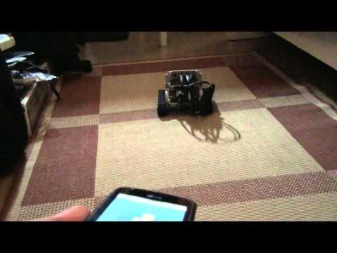
Android Remote Control with Bluetooth
http://www.youtube.com/watch?v=fPV9YG6XnG4
Notes:
- This is an example of a clever use of the Lego NXT.
-You only need to show enough of this video to give an idea of what's going on in here. How much of the video to show depends on the time constraints and how interested the students look.

Slide 7
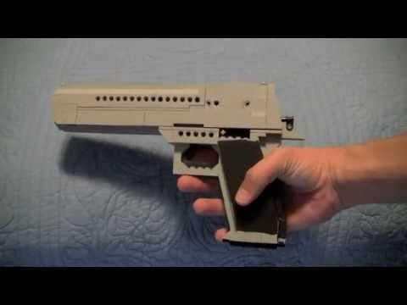
Lego Desert Eagle
http://www.youtube.com/watch?v=LAQmMlSd-Mo
Notes:
-You only need to show enough of this video to give an idea of what's going on in here. How much of the video to show depends on the time constraints and how interested the students look.

Slide 8
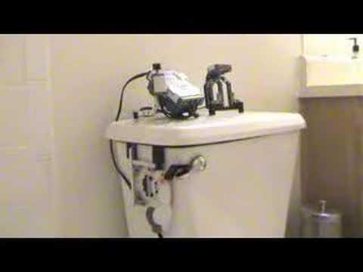
Lego Automatic Toilet Flusher
http://www.youtube.com/watch?v=xvZU2PchUmY
Notes:
- This is an example of a clever use of the Lego NXT.
- You only need to show enough of this video to give an idea of what's going on in here. How much of the video to show depends on the time constraints and how interested the students look.

Slide 9
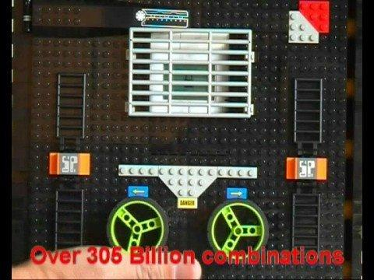
Lego Safe
http://www.youtube.com/watch?v=XjWt4O4bSjQ&feature=related
Notes:
- This is an example of a clever use of the Lego NXT.
- You only need to show enough of this video to give an idea of what's going on in here. How much of the video to show depends on the time constraints and how interested the students look.

Slide 10
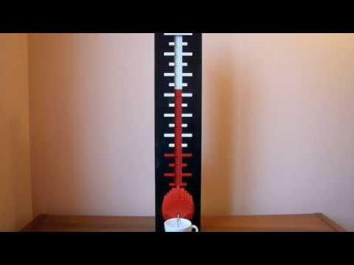
Giant Thermometer
http://www.youtube.com/watch?v=plQ8Y3XAKvA
Notes:
- This is an example of a clever use of the Lego NXT.
- You only need to show enough of this video to give an idea of what's going on in here. How much of the video to show depends on the time constraints and how interested the students look.

Slide 11
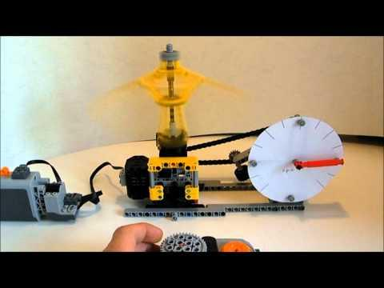
Lego Centrifuge
http://www.youtube.com/watch?v=-k2xWoyP-SA&feature=related
Notes:
- This is an example of a clever use of the Lego NXT.
- You only need to show enough of this video to give an idea of what's going on in here. How much of the video to show depends on the time constraints and how interested the students look.

Slide 12
Demonstration
Demonstration of the movements listed in the handout
Notes:
Plug one of the completed robots into your computer, open up the NXT software, and demonstrate the movements listed in the day 2 handout, showing how the different blocks and different settings for a single block change the way the robot moves.

Slide 13
Challenges
Challenge 1: Drive into Garage
Challenge 2: Back into Garage
Challenge 3: Two Laps around a Track
Challenge 4: Two Laps backwards around a Track
Notes:
- Explain the 4 challenges as described in the handout.
- Give each student a handout.
- Divide the students into groups if there are not enough robots for each person.
- Give each group a 5 minute bot, which should have been assembled by you or someone else already.
- Have the students begin the challenges. The students should have around 30 minutes to do the challenges.
- Leave this slide on the screen while the students work to give them a quick reference for what they should be doing.
- Wander around answering questions as needed.

Slide 14
Review/Discussion
What was your favorite one of the NXT devices I showed you?
What do you think of NXT programming? Was it easy? hard? fun?
Any other comments?
Notes:
- Do the review/discussion 5 or 10 minutes before the end of the lesson
- Try to get a few students to answer each of these questions

