Slide 1
Scratch Programming
Brian Cain

Slide 2
What is Programming or Software Engineering?
The process of turning an idea or concept into a working and often interactive system
Often used to solve a goal or accomplish a task (i.e. problem solving)
Examples?
  Cars, Planes, Space Rockets...
  Facebook, Google, Twitter, Amazon...
  iOS, Android, Windows, Mac OS X, Linux
  Accounting software , Statistics software, Mathematics software
  ...and even more!

Slide 3

What is Scratch?
"Scratch is a programming language that makes it easy to create your own interactive stories, animations, games, music, and art" -- info.scratch.mit.edu/About_Scratch
Notes:
Created by MIT to help students like yourselves learn programming

Slide 4
What is Scratch?
A visual way to introduce programming to students
Works in a similar way to jigsaw puzzles
Makes creating interactive software like video games, storyboards, or study software easy

Slide 5
Scratch Examples
Notes:
Open the program and choose some fun ones to show

Slide 6
Short Tutorial with the Basics
We're going to make our first Scratch game
Open up Scratch and follow the instructions to follow
Notes:
Feedback: " You might want to incorporate self-tests, e.g., what will happen if 10 seconds is changed to 20 seconds; e.g., 20 seconds forward and 10 steps back, etc."

Slide 7
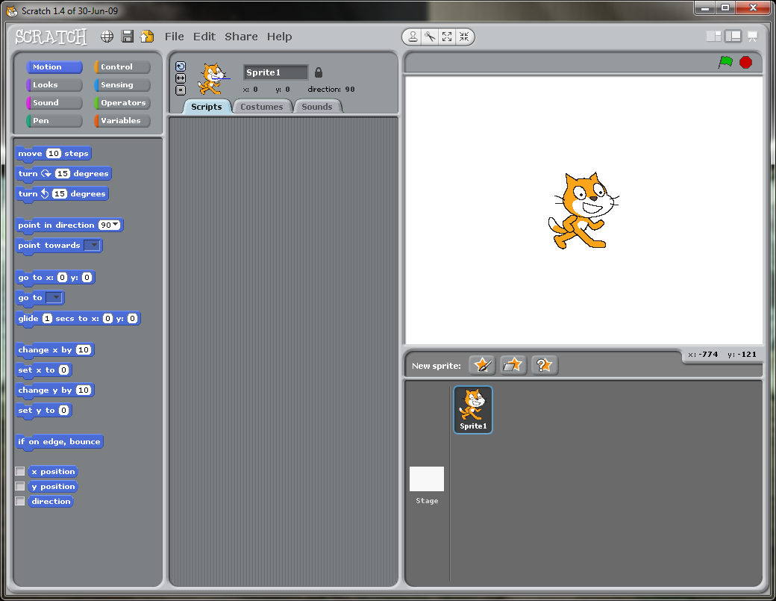
Notes:
Here is a new program in Scratch

Slide 8
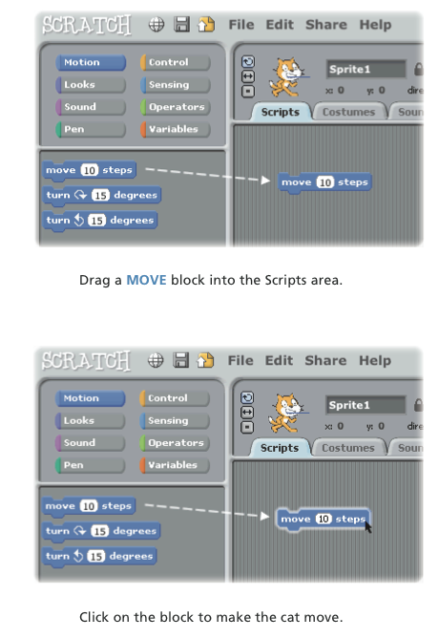
Notes:
Go into the motion section, and drag the first block that says "move 10 steps" onto your 'Scripts' area in the middle
You can click on the block to perform the action, you might have to change the steps to a higher number to see a more drastic movement

Slide 9
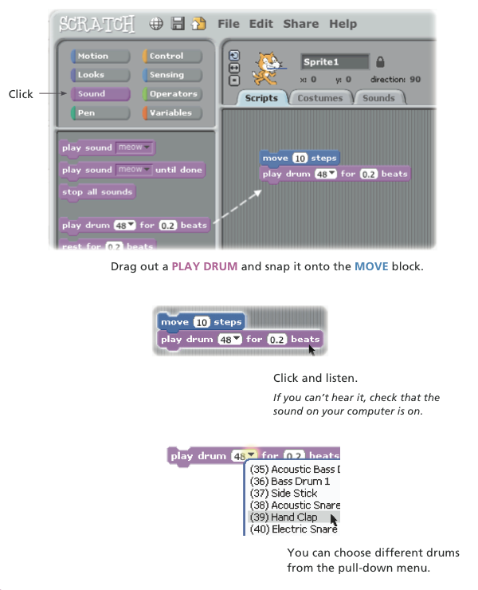
Notes:
If they don't have sound, just go along with it.
Click on the Sound category, find the brick that says "play drum for...." and snap it into place under the move brick, similar to a lego or puzzle piece.
Click on the group of bricks to perform the action.

Slide 10
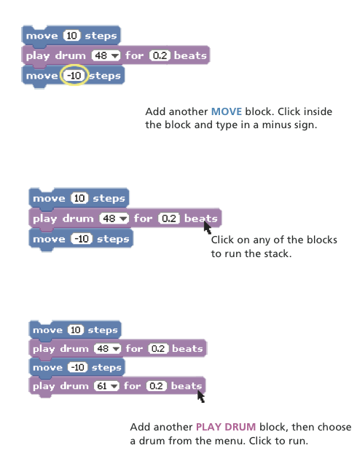

Slide 11
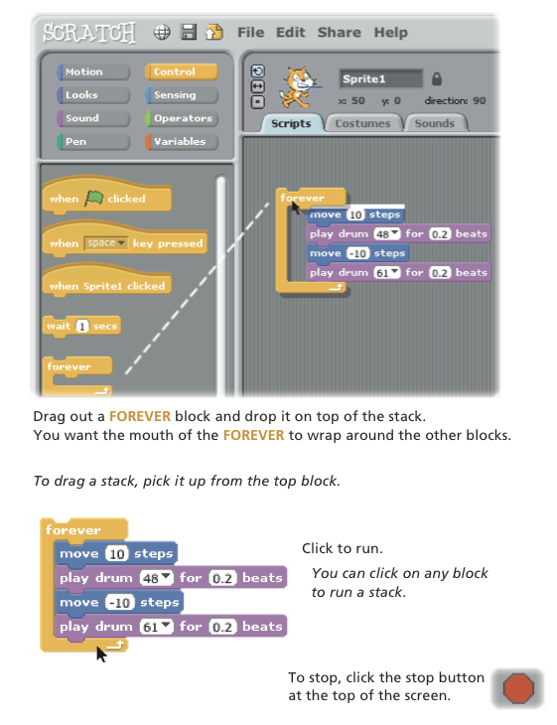

Slide 12
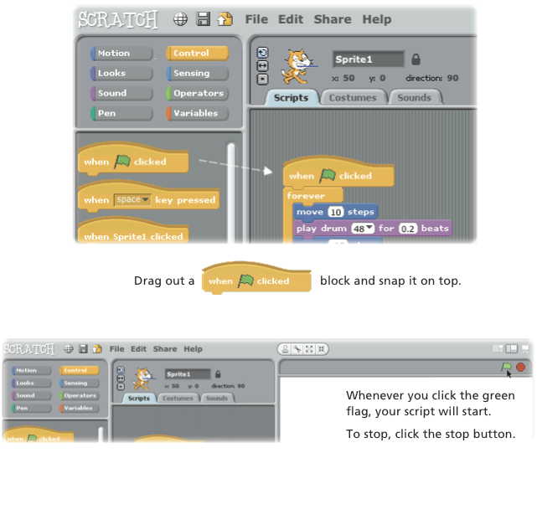

Slide 13
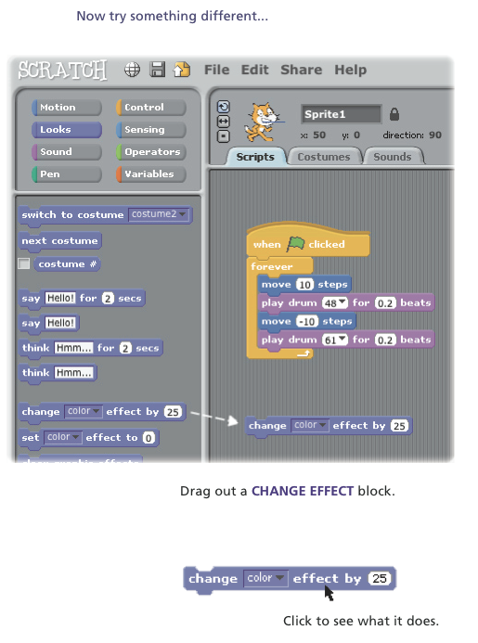

Slide 14
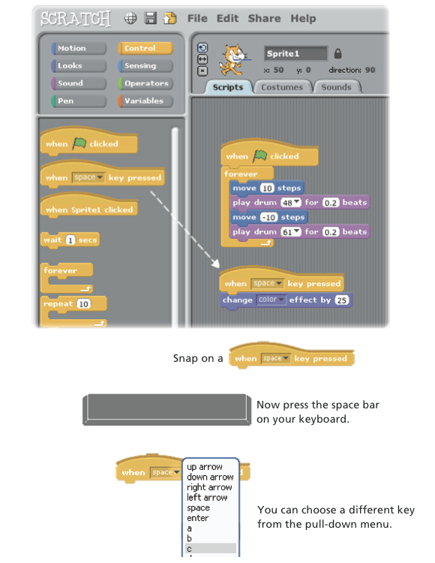

Slide 15
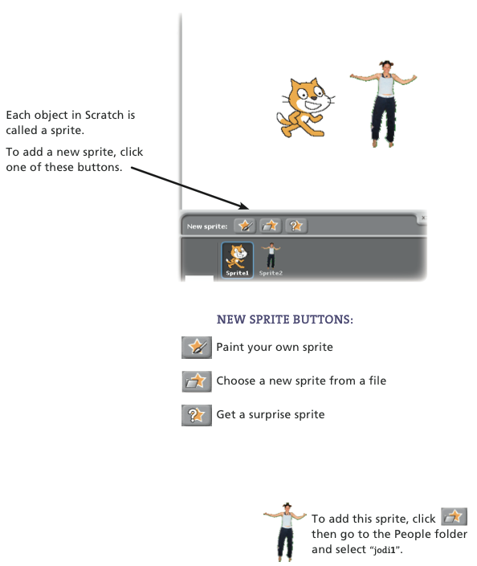

Slide 16
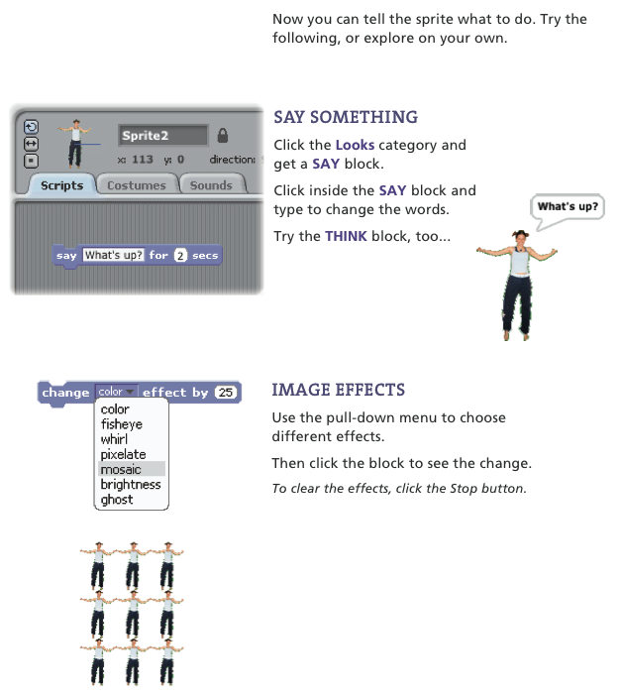

Slide 17
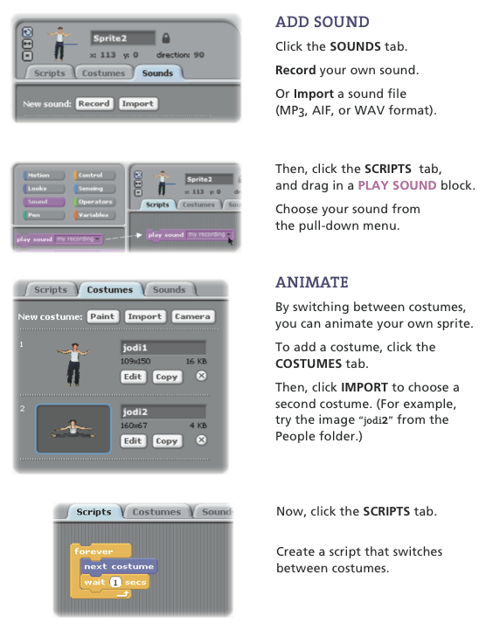

Slide 18
Try on your own
Take a look at the first example of a Scratch program and go through the instructions
See if you can complete the program like the instructions have

Slide 19
Making a Quiz
First, let's take a look at the completed example...
Notes:
Give them this completed example and have them build off of it?

Slide 20
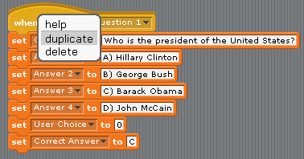
Making a Quiz: Question 3
Let's make another question here
Go to question 1, right click it and select duplicate

Slide 21
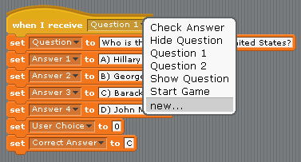
Making a Quiz: Question 3
Now, select the drop down menu and create a new question name called "Question 3"
Notes:
A box will come up, type "Question 3" in it to make it new

Slide 22
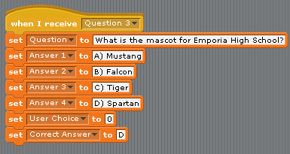
Making a Quiz: Question 3
Create your own custom question, here is mine:
Notes:
First you're going to want to write out the question so the player can see it.
Then you're going to want to give the user a choice of answers.
Set the user choice to 0 so they can't just hit go and get the right answer
Don't forget to set the right answer, so Scratch can know if the player got it right

Slide 23
Making a Quiz: Question 3
Now let's mess with the main logic, and add our question to the quiz. First, let's break apart that big block:

Slide 24
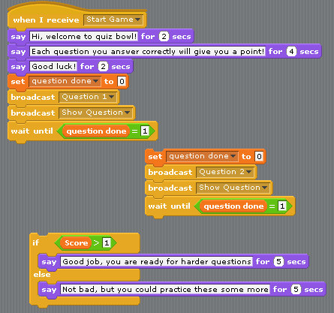
Notes:
Right click on the block that you moved out, and duplicate it.

Slide 25
Making a Quiz: Question 3
Now that you have broken apart that large block, copy the block "set question done to 0" block and duplicate it for your third question
In the newly made piece, make sure the second yellow block is "broadcast Question 3", so that the quiz doesn't ask question 2 twice
Now place the new block, plus the old block, in order

Slide 26
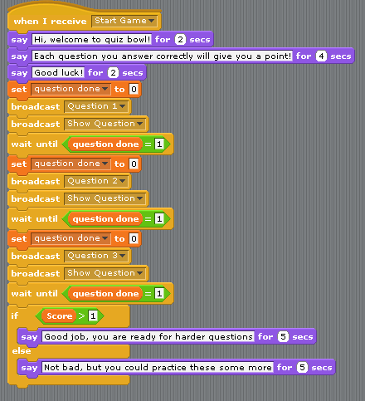
Notes:
Don't forget to change the broadcast to Question 3, so it asks the right question.

Slide 27
Making a Quiz: Question ??
If you'd like to add more questions, and make your own custom quiz, follow these steps.
Remember to add your new questions to the program so that it can ask the user!

Slide 28
Conclusion
Make a quiz relating to your first exam to help you and your fellow peers study
If you want this program at home, it's free! Just go to scratch.mit.edu/ to download and install it.

Slide 29
References
info.scratch.mit.edu - For the quotes, and short tutorial included in these slides (http://info.scratch.mit.edu/sites/infoscratch.media.mit.edu/docs/ScratchGettingStartedv14.pdf)
Scott Bell, former GK-12 fellow who got me started making the Scratch quizzes

