Slide 1
What is a sensor?
Brian Cain
Computer and Information Sciences
GK-12 Fellow
Kansas State University

Slide 2
Sensors
Sensor technology is used for various tasks such as detecting....
Temperature (Thermometers)
Pressure (Barometer)
Humidity (Humistor)
Sound (Microphones)
Visuals (Camera)
....and more!
A sensor is a device which responds to a signal

Slide 3
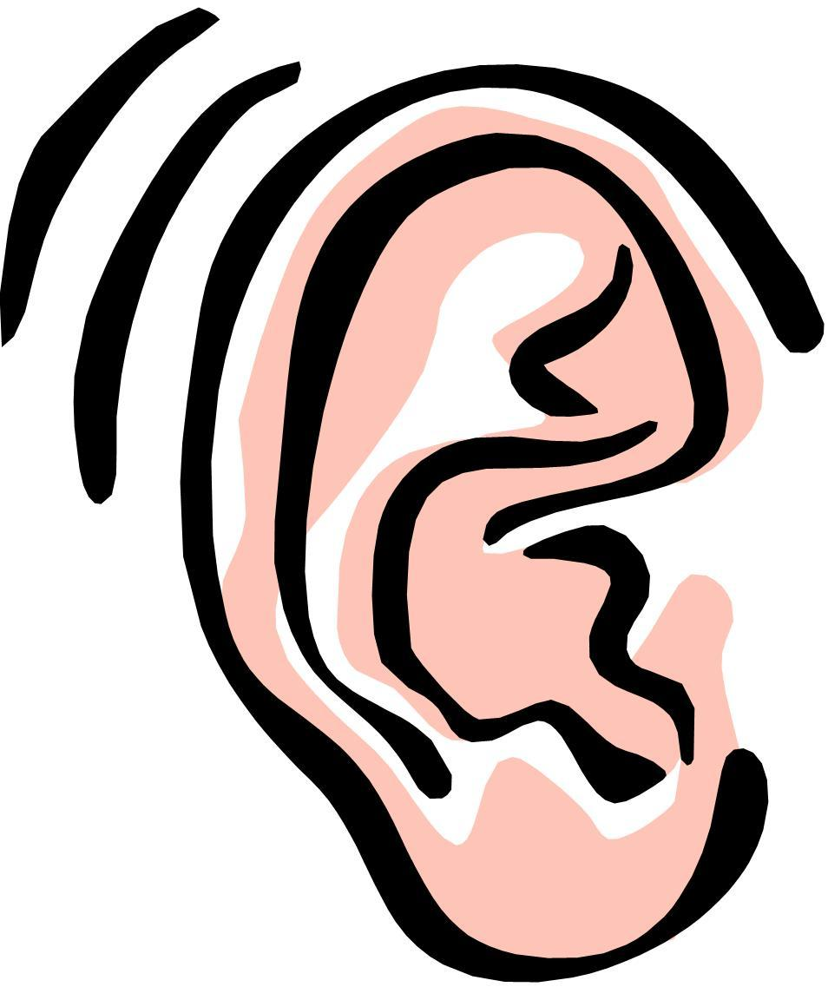
Biological Sensors
Some sensors you might already be very familiar with:
Ears
Tongue
Nose
Eyes
Fingers
These sensors tell your body and brain different information about the environment around you
Notes:
These sensors take in information that allow your brain to process it

Slide 4
Technological Sensors
Much like our own sensors, human-made sensors take in information from the environment and gives information back
Let's take a look at some common sensors and see how they work....

Slide 5
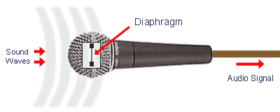
Microphones
Microphones are a sensor of sound waves
How do they work?
Sound waves travel from a source through the air
A sensor called a diaphragm vibrates to the same frequency of the sound that is gathered by the microphone
That frequency produced by the diaphragm is translated into a digital signal and sent to a computer

Slide 6
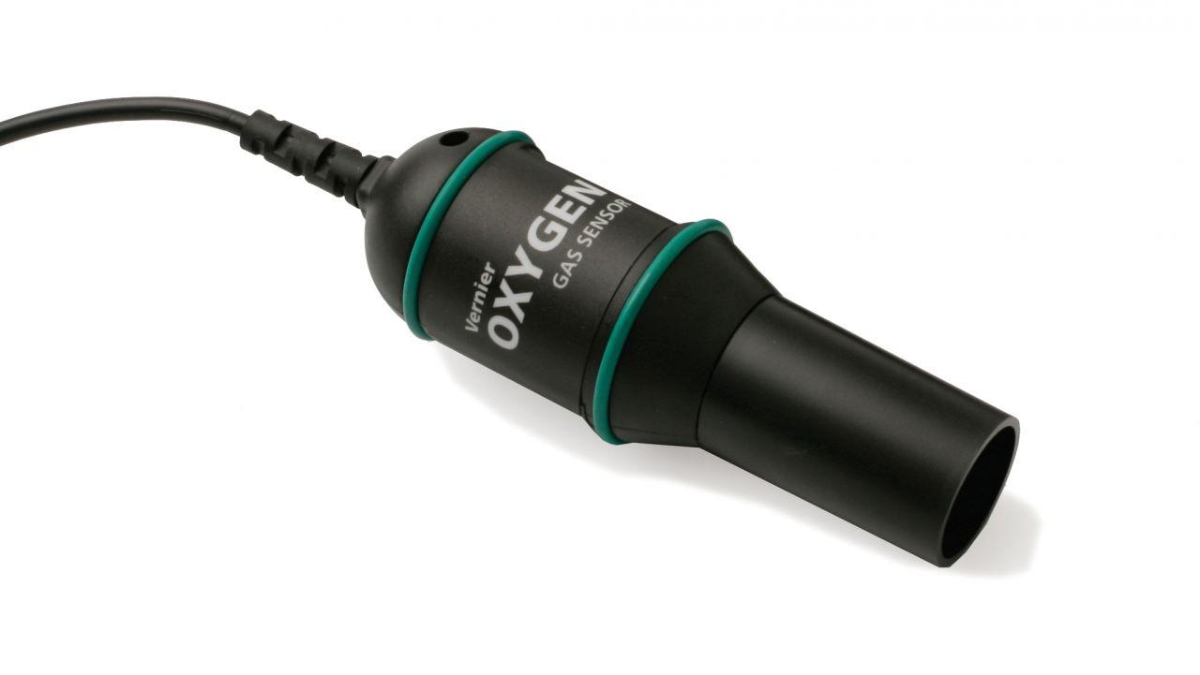
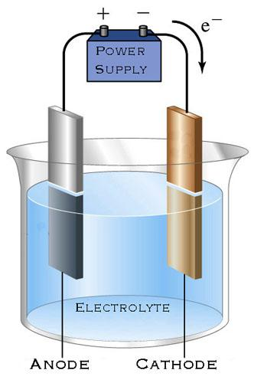
Gas Sensors
Gas Sensors are used to monitor gaseous air levels such as oxygen (O2)
How do they work?
The Vernier O2 Gas Sensor measures the oxygen concentration in the range of 0 to 27% using an electrochemical cell
The cell contains a lead anode and a
gold cathode immersed in an electrolyte

Slide 7
Gas Sensors (continued)
How do they work?
Oxygen molecules entering the cell are electrochemically reduced at the gold cathode.
This electrochemical reaction generates a current that is proportional to the oxygen
concentration between the electrodes.
The sensor output is a conditioned
voltage proportional to the reaction
current.

Slide 8
Thermometers
Thermometers are a sensor of temperature
How do they work?
The volume of the liquid is relative to the surrounding temperature.
In other words, as the surroundings of the thermometer goes up, the volume in the class increases, giving a reading that we can understand as temperature.
Notes:
Possible experiment for making your own: http://www.howstuffworks.com/therm1.htm

Slide 9
Let's Make a Sensor
We're going to make a Thermometer. Here is what you will need...
1 Glass Jar with hole in lid
Cold Water
Some Silly Putty
1 Drinking Straw
Hot Water

Slide 10
Let's Make a Sensor
Step 1: Place your jar on the table to steady it
Step 2: Fill your jar with cold water to the brim of the jar
Step 3: Screw the lid onto the jar. Some water might fall out, but that's ok.
Step 4: Insert straw into the hole and seal it up with the silly putty
Step 5: Place jar into tub, and fill the tub with hot water.
Step 6: Observe!
Notes:
This might be split up into multiple slides with photos

