Slide 1
Scratch Programming

Slide 2
Introduction
Who here likes video games?
Who here likes movies?
Who wants to try making little movies and games of their own?
Who here has done computer programming before?
Who here has heard of/used Scratch?
Notes:
- Ask the students these questions and get their answers by a show of hands

Slide 3
With the Scratch You Can:
Create small games and animated movies
Share your creations with others
View/play/download/customize the creations of others
Hopefully have fun
Learn about computer programming

Slide 4
Scratch Website Demonstration
http://scratch.mit.edu/
Notes:
Go the the website and show some example programs there: (5-10 minutes)
MyLife Episode #10 Part 1
To demonstrate the search function: Search for bert
Click on one of the one that says "add yourself screaming at bert..." and play it for them
Explain the remix feature for them about how Scratch users can modify and customize others' program
Do this by clicking the remix tree button which will show all the different customizations people have made where they added themselves screaming at bert. Show where the tree ends and where it begins.

Slide 5
Scratch Demonstration
Notes:
Having finished on the website, open up the Scratch program and show a variety of the different example programs included with Scratch. They can be found by going to File > Open > Examples. (5 minutes)
Be sure to note that the students can experiment with and modify these examples
Create a new Scratch program and explain/demonstrate what each of the different categories of blocks do (5-10 minutes)

Slide 6
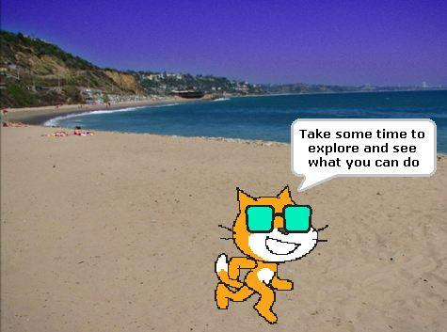
Activities
Scratch Exercise 1
Scratch Exercise 2
Scratch Exercise 3
Explore Scratch
Ask Questions if you get
Stuck
Notes:
Hand out the three exercises as hard copies or pdfs on their computers and tell the students to do them.
Leave this slide on the projector screen so that the students can have a quick reference to what they should be doing.
Wander around answering any questions students have.
The students may get distracted by all the features of Scratch and not do the lessons. This is normal. Get them back on task if you can but do not be too concerned about it.

Slide 7
What Do You Think of Scratch?
Was it easy or hard?
Was it fun?
What was something interesting you found?
Notes:
- Start asking these questions approximately 5 minutes before the session ends.
- Try to get a few students to answer each question.

Slide 8
References
http://scratch.mit.edu/

