Slide 1
Squishy Circuits
Building circuits and batteries with dough made in the kitchen.

Slide 2
Materials

Slide 3
What is missing?

Slide 4
A Closed Circuit

Slide 5
A Short Circuit

Slide 6
Add Insulating Dough

Slide 7
An Open Circuit

Slide 8
Use the Insulating Dough

Slide 9
A Parallel Circuit

Slide 10
A Series Circuit

Slide 11
A Series Circuit

Slide 12
Resistance Formulas
Series Circuits
R_{Total}=R₁+R₂
Parallel Circuits
R_{Total}=(R₁R₂)/(R₁+R₂)

Slide 13
R₂=250Ω

Slide 14
R2=500Ω

Slide 15
R₂=750Ω

Slide 16
The Solar Panel

Slide 17
6V=4(1.5V)

Slide 18
Let’s Make a Battery

Slide 19
Let’s Make a Battery

Slide 20
Let’s Make a Battery

Slide 21
Let’s Make a Battery

Slide 22
V=V₁+V₂+V₃+V₄

Slide 23
How to Measure V_{i}

Slide 24
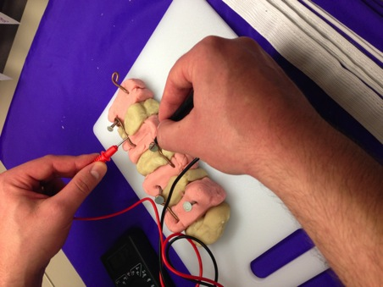
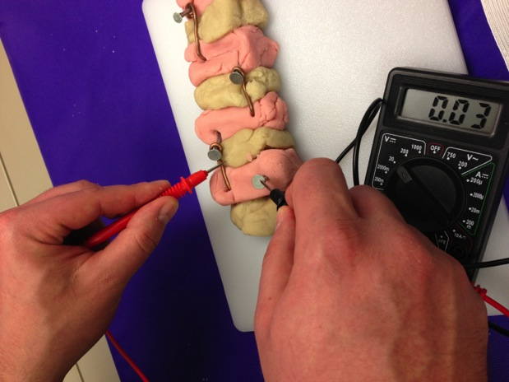
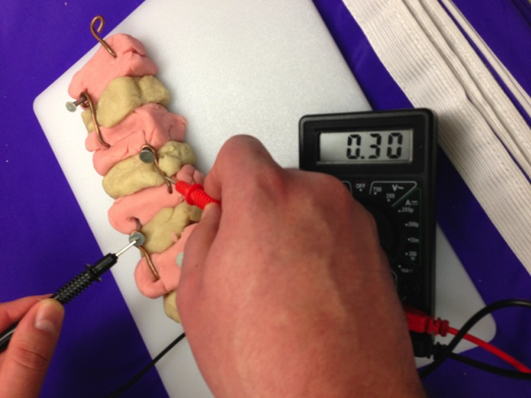
Measure V₁,V₂,V₃ , and V₄

Slide 25
Measuring V

Slide 26
More Components

Slide 27
The Buzzer

Slide 28
The Photoresistor

Slide 29
The Photoresistor

Slide 30
The Photoresistor

Slide 31
Demo: Squishy Sound

Slide 32
Thank You!
http://courseweb.stthomas.edu/apthomas/SquishyCircuits/index.htm

