Slide 1
Energy, Waves, and Sound
James Shaffer
Kansas State University

Slide 2
Building a speaker

Slide 3
Materials
Computer
Small amplifier
Magnet wire
Speaker wire
Male-male audio cable
Hot glue gun
2 paper plates
2 2”x8” strips of printer paper
2 3”x5” notecards
4 ceramic disc magnets
Software: Audacity (free download at http://audacity.sourceforge.net/)

Slide 4
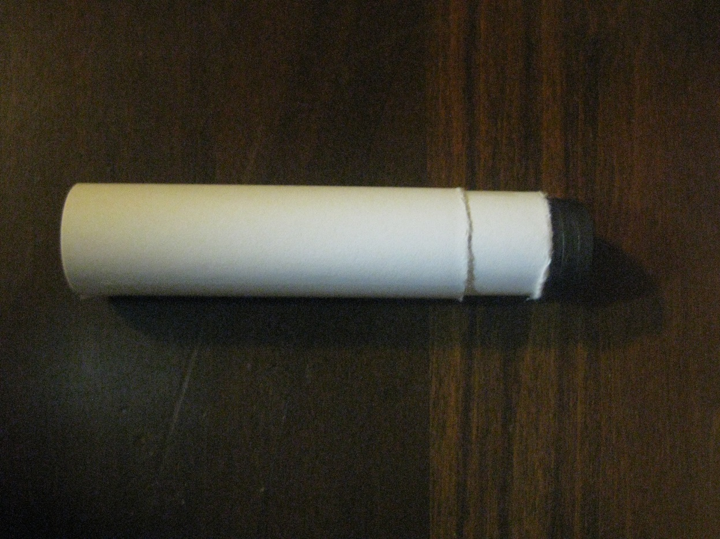
Step 1: The Coil
Stack your magnets together, and roll them in to a strip of paper.
Tape the roll shut.
Roll your first roll in to the second strip of paper.
Tape the second roll shut.

Slide 5
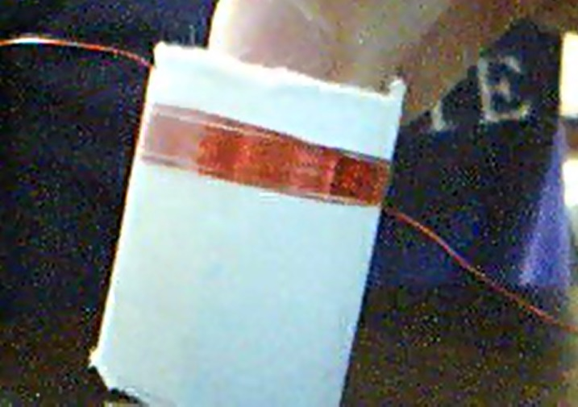
Step 1: The Coil
Slide off the outermost roll of paper. This will hold your coil.
Wrap about four feet of magnet wire around your roll of paper.
When you are done, tape the magnet wire in place.

Slide 6
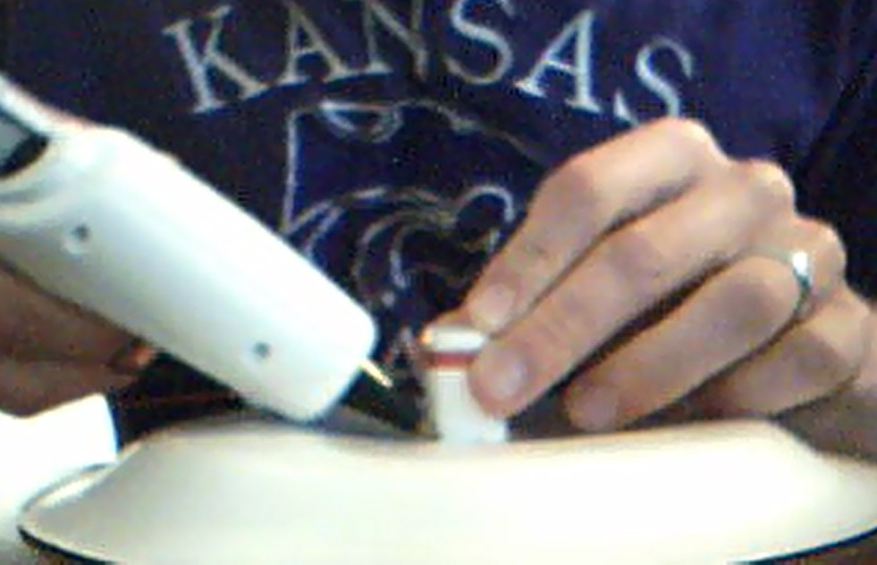
Step 2: The Diaphragm
Place a paper plate upside down in front of you.
Find the center of the plate.
Hot glue the speaker coil to the center of the plate.

Slide 7
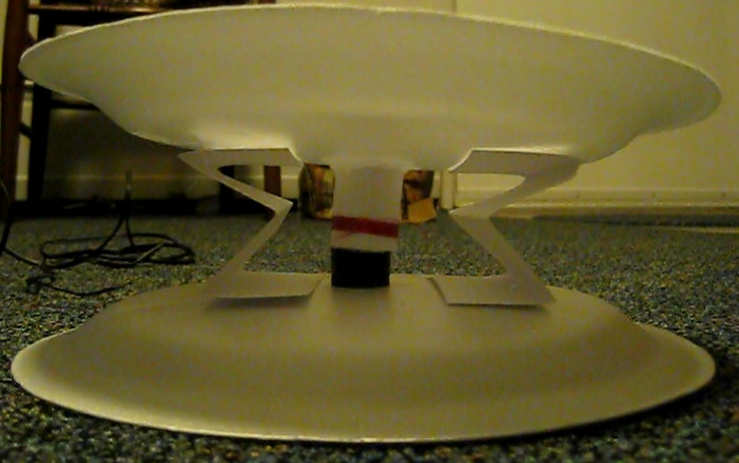
Step 3: The Speaker Body
Fold two notecards in to an “M” shape.
Tape the notecards to the plate on either side of the coil.
Tape the other side of the notecards to a second paper plate.
Slide a magnet under the coil. Does your speaker look like the picture?

Slide 8
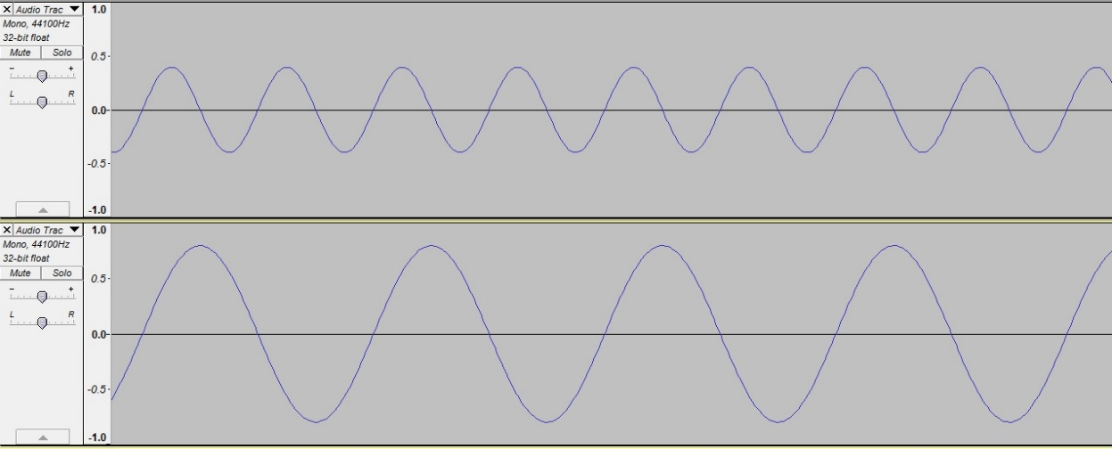
Testing
One group at a time can bring their speaker to the front of the class.
We will test them using the two tracks shown.
Which track will be louder?
Which track will be higher pitched?

Slide 9
Sound is a wave
Physical energy, such as clapping or vibrating your voice box, causes air to be disturbed.
This disturbance travels in waves.
We hear this disturbance when it reaches our ear drums and causes them to vibrate.

Slide 10
Properties of Sound
Amplitude can be thought of as the height of a wave.
This affects the volume of sound.

Slide 11
Properties of Sound
Which track is louder?

Slide 12
Properties of Sound
Frequency can be thought of as the number of times a wave peaks in a given space.
The higher the frequency of a sound wave, the higher the pitch.

Slide 13
Properties of Sound
Which track is higher-pitched?
1
2
3
4
5
6
7
8
9
1
2
3
4

Slide 14
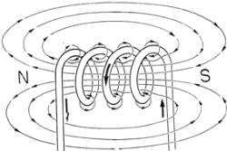
Solenoids
All electric currents generate a weak magnetic field.
A solenoid concentrates those fields to produce a strong central field.

Slide 15
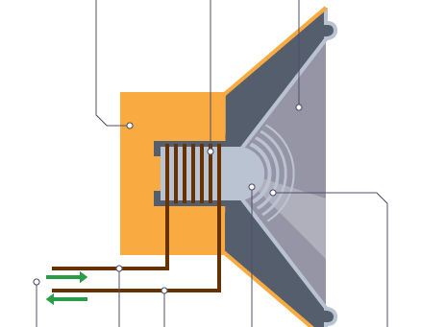
Solenoids in speakers
Signals are sent to a speaker as current in a solenoid.
When current passes through the solenoid, it makes a magnetic field.
This field interacts with a permanent magnet in the speaker, causing it to move and make vibrations.

Slide 16
Challenges
How can we build a louder speaker?
How can we reduce the buzzing in our speakers?

Slide 17
Note to instructors on setup with computer
Before you connect the speaker to a sound source, you will need to remove the insulation from the ends of the magnet wire. This can be done with a match, or with sandpaper.
In order to connect the plate speakers to a computer, I had to use a small amplifier (not unlike the ones you would find in a car/home theater stereo system.) There are many that sell on amazon for around $20 (I used a Lepai LP-2020A+.) You will need one with a 3.5 mm auxiliary input. Use speaker wire to connect the speaker to the amp, and a male-male audio cable to connect the amp to the computer.

Slide 18
Note to instructors on setup with computer
The program used to generate the test track is Audacity, a free download available at http://audacity.sourceforge.net/
To generate a tone:
In the tool bar at the top of the screen click “Generate,” then “Tone.”
Specify the desired frequency, amplitude, and duration.
Click OK.

