Slide 1
Scratch for Arduino (S4A) and the Electromyography (EMG) Sensor
Mitchell Neilsen
INSIGHT Summer Institute 2014

Slide 2
Cyber-Physical Systems (CPS)
A cyber-physical system (CPS) is a system of collaborating computational elements controlling physical entities –wikipedia. The pre-cursor generation of cyber-physical systems are often referred to as real-time embedded systems. In embedded systems the emphasis tends to be more on the computational elements, and less on an intense link between the computational and physical elements. Unlike traditional embedded systems, a full-fledged CPS is typically designed as a network of interacting elements with physical input and output instead of as standalone devices.^{[1]} Closely related areas are robotics and sensor networks.

Slide 3
CPS Future Potential
Ongoing advances in science and engineering will improve the link between computational and physical elements, dramatically increasing the adaptability, autonomy, efficiency, functionality, reliability, safety, and usability of cyber-physical systems.
This will broaden the potential of cyber-physical systems in several dimensions, including:
intervention (e.g., collision avoidance);
precision (e.g., robotic surgery and nano-level manufacturing);
operation in dangerous or inaccessible environments (e.g., search and rescue, firefighting, and deep-sea exploration)
coordination (e.g., air traffic control, war fighting);
efficiency (e.g., zero-net energy buildings); and
augmentation of human capabilities (e.g., healthcare monitoring, prosthetics, etc.).^{[2]}

Slide 4
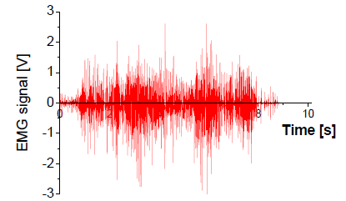
Electromyography (EMG)
Electromyography (EMG) is a technique for evaluating and recording the electrical activity produced by skeletal muscles – from wikipedia
Study that deals with the detection, analysis, and use of electrical signals that emanate from contracting muscles – from “The physiology background of EMG” by Lida Mademli

Slide 5
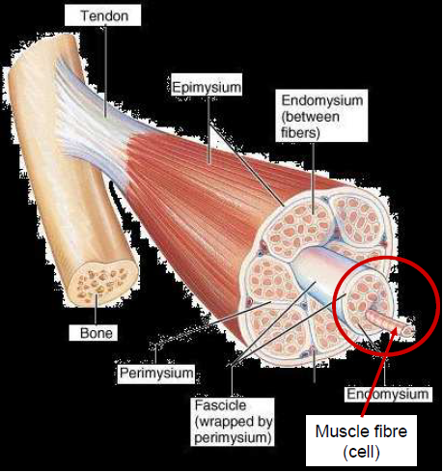
Skeletal Muscle Organization
Muscle consists of:
Muscle fascicles (bundles of muscle fibres)
Muscle fascicles are wrapped by perimysium
Muscle fascicles consist of
Muscle fibres (muscle cell)
Muscle fibres are wrapped by endomysium
The muscle fibre is what contracts

Slide 6
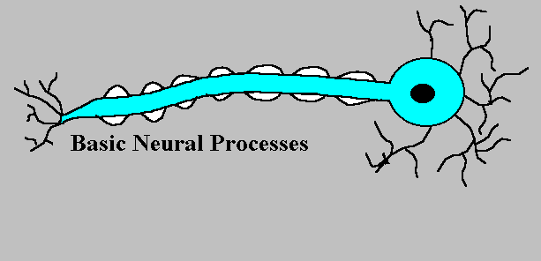
Motoneuron
How the electrical stimulus travels down the motoneuron to innervate (activate) the muscle fibre.
The change in polarity travels down the neuron (action potential)
Neurotransmitter (acetylcholine) is released from terminal end

Slide 7
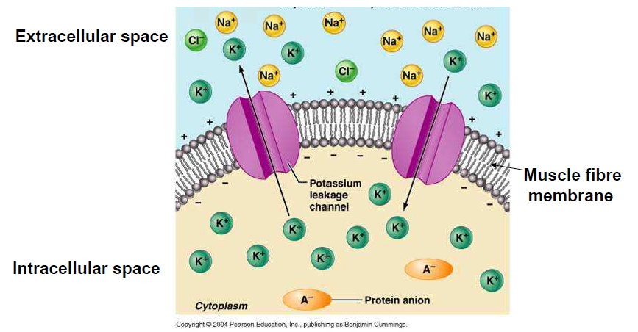
Muscle at Rest
Resting potential of muscle = ~ -90mV (Purves et al 2001)
In the absence of an impulse, the inside is electrically negative and the outside is positive

Slide 8
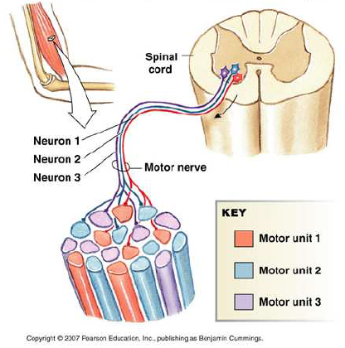
Muscle and Nerve
The Motor Unit (MU)
One muscle may have many motor units of different fibre types (slow or fast twitch)
One motor unit can have from 5 to few thousands muscle fibres.
The motor unit is the brain’s smallest functional unit of force development control.

Slide 9
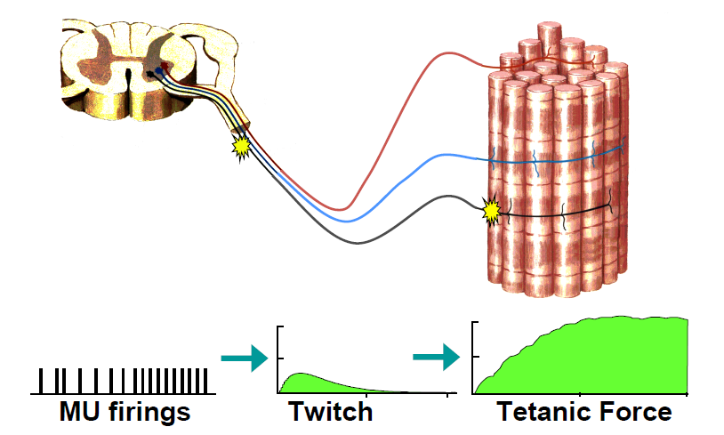
Motor Units and Force

Slide 10
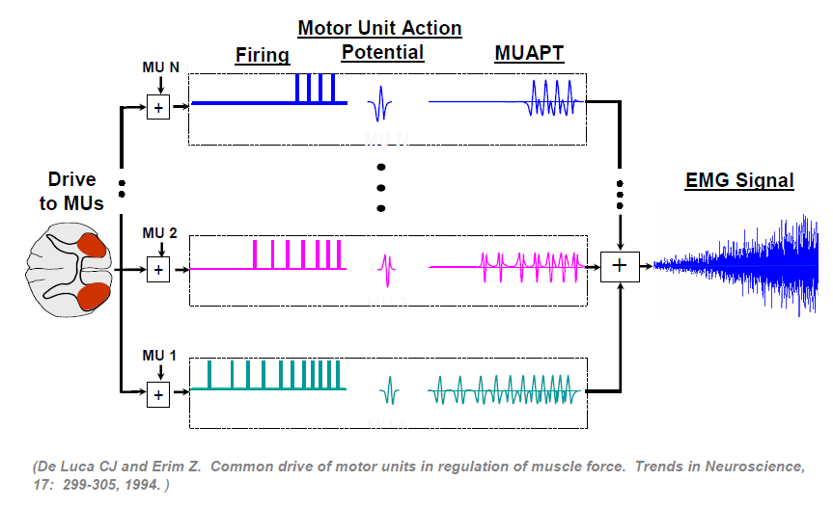
EMG Signal

Slide 11
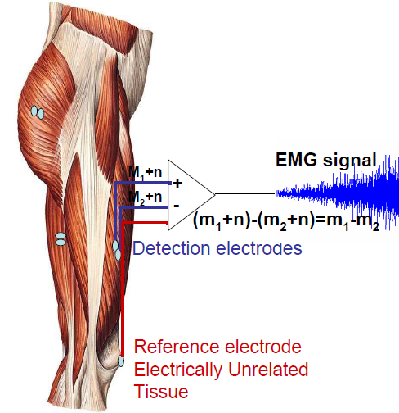
EMG Signal Capture
Differential amplifier
Input from two different points of the muscle
Close (usually 1-2cm)
Electrode alignment with the direction of muscle fibres implies increased probability of detecting same signal
Subtracts the two inputs
Amplifies the difference
Optionally, rectify and smooth signal

Slide 12
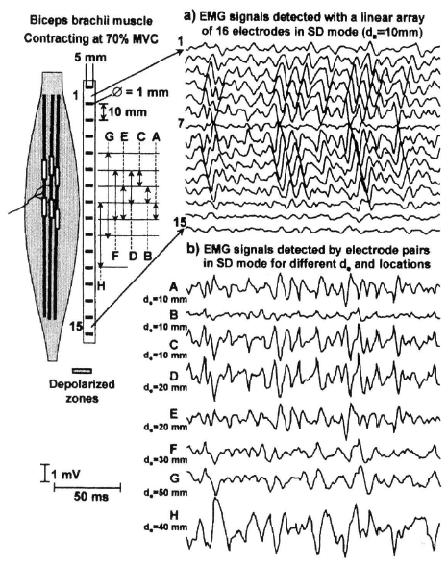
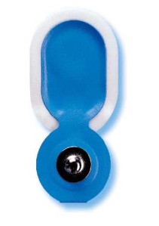
Physiology of the EMG
Above the innervation zone, electrode 7 small amplitude.
Above the myotendinous junction, more tendon tissue, electrodes 14 and 15 small amplitudes.
Others radiate out from electrode 7.
electrode

Slide 13
Types of EMG Sensors
sEMG = surface EMG

Slide 14
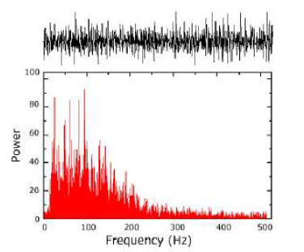
Characteristics of EMG Signal
Amplitude range:
0 - 10 mV (+5 to -5) prior to amplification
EMG frequency:
range of 10 - 500 Hz
Dominant energy:
50 - 150 Hz
Peak in the neighborhood of 80 - 100Hz

Slide 15
EMG Frequency
Motor Units
Slow twitch: 75 - 125 Hz (twitches/sec)
Fast twitch: 125 - 250 Hz

Slide 16
Most Usual Parameters in Biomechanics or Physiology
Time domain:
RMS or average of rectified EMG
Frequency domain:
FFT analysis (spectral analysis)
Power density
Mean power frequency
Median power frequency

Slide 17
EMG During Fatigue – from Physiology of EMG, Mademli

Slide 18
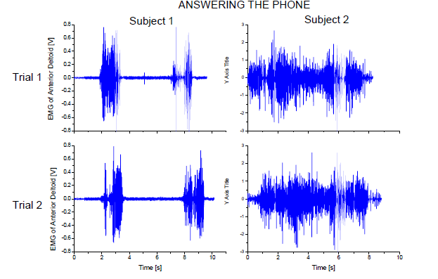
Potential Use of EMG
It is possible that the EMG signal during a specific movement will demonstrate inter-individual differences. This can be used in user authentication systems (ACTIBIO).

Slide 19
Potential Use of EMG
The muscle activity recorded using sEMG can be useful as an input signal to the system which can control devices such as keyboard, mouse or computer. (Arjunan, et al., 2007)
“The strength of sEMG is a good measure of the strength of contraction of muscle”. (Arjunan, et al., 2007)
Not always true! E.g., EMG During Fatigue

Slide 20
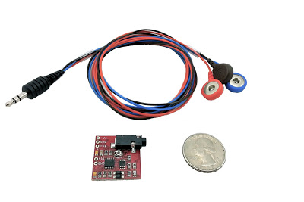
Muscle Sensor
Advancer Technologies Muscle Sensor v3: http://www.advancertechnologies.com/p/muscle-sensor-v3.html

Slide 21
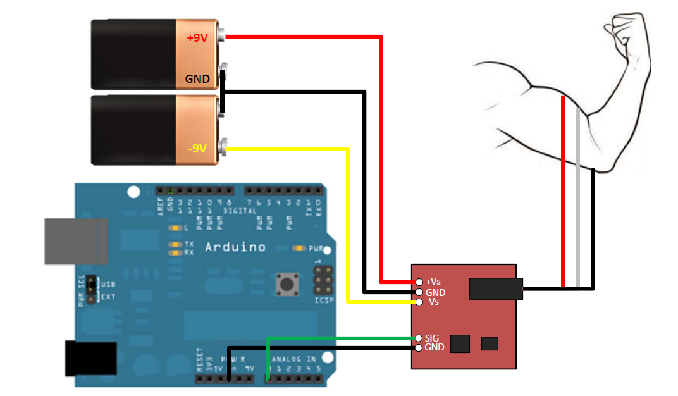
Hardware Configuration

Slide 22
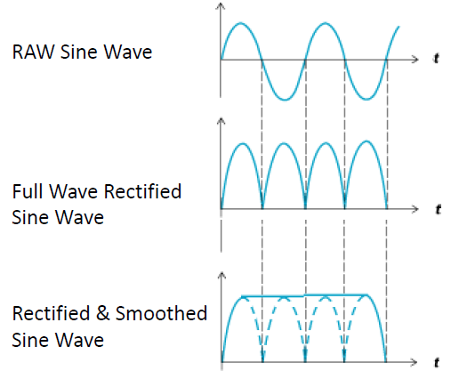
Rectified and Smoothed Signal
These sensors do not output a RAW EMG signal, but rather an amplified, rectified, and smoothed signal the can be used directly with a microcontroller’s analog-to-digital converter.
This difference can be illustrated using a simple sine wave as an example.

Slide 23
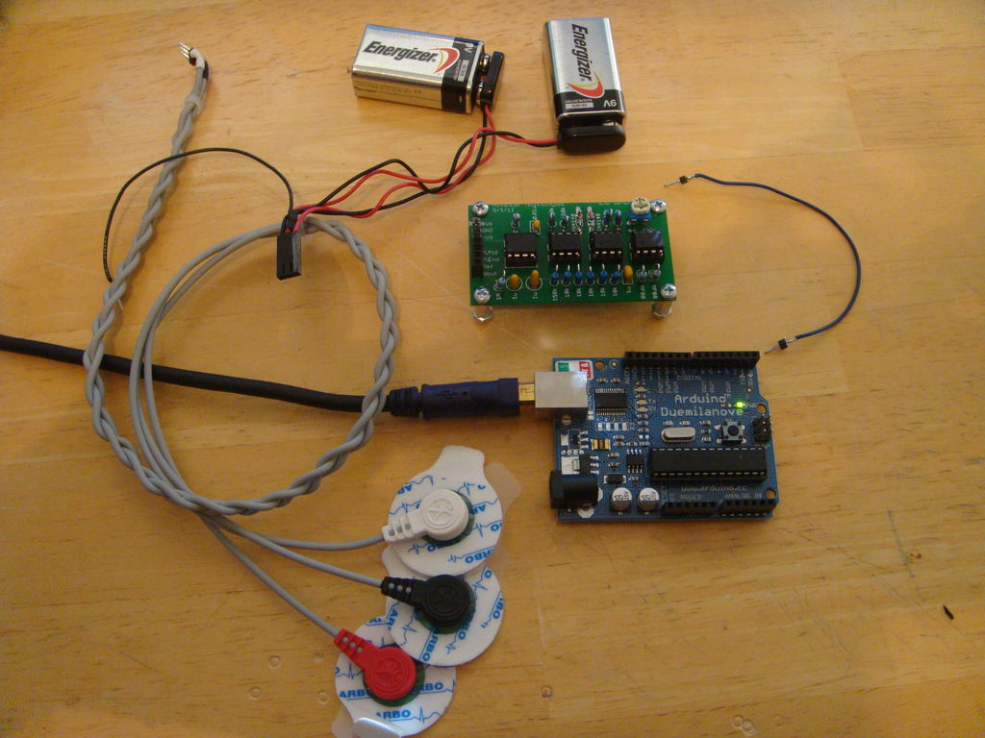
Muscle Sensor Kit

Slide 24
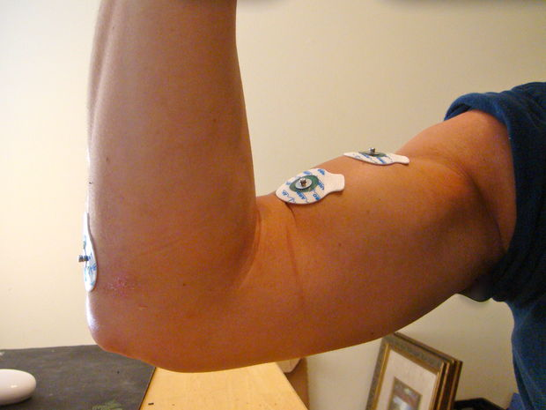
Connect Sensors
See http://www.youtube.com/watch?v=VnrsWdA6dzE&feature=player_embedded

Slide 25
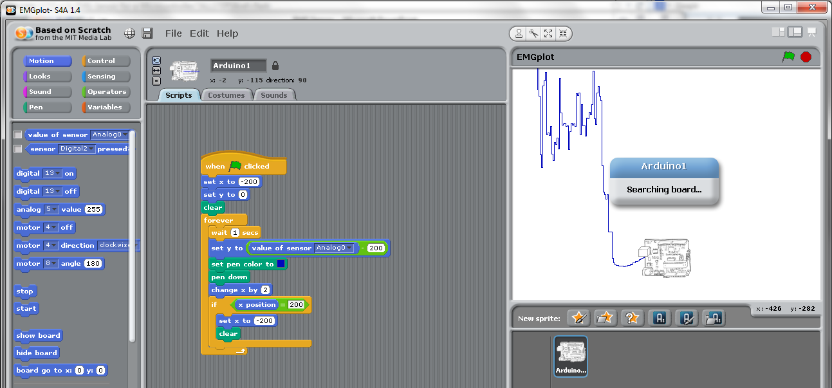
Connect to Arduino
Simple Scratch4Arduino Example

Slide 26
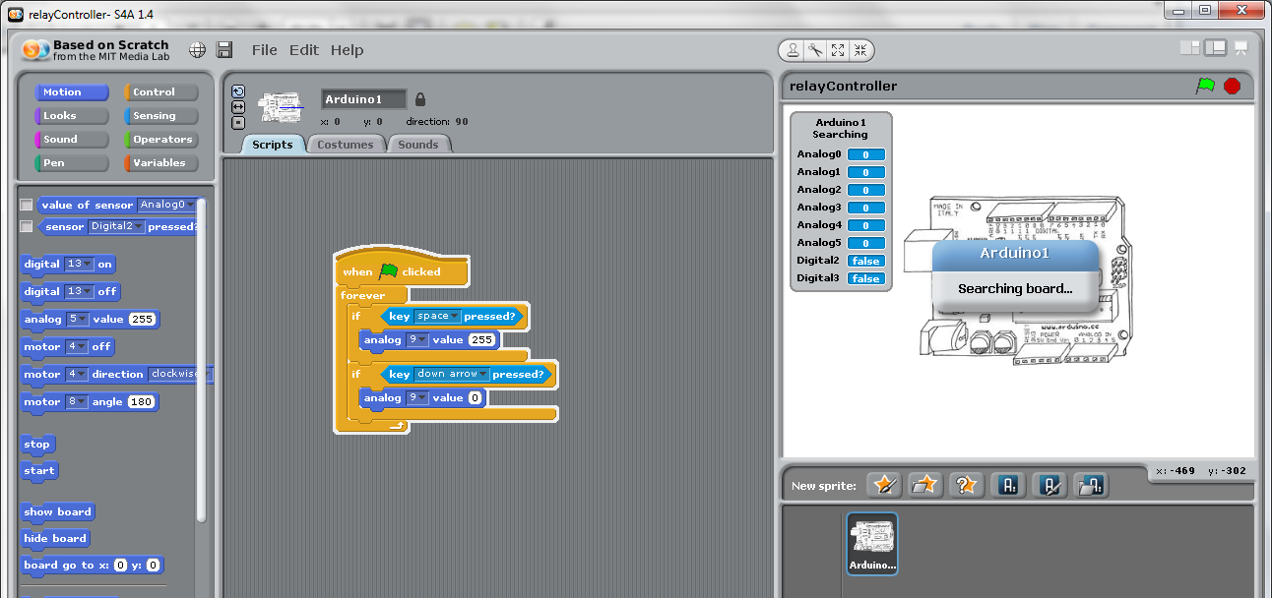
Arduino to Drive Relay

Slide 27
Now, put the two together
If the muscle activity reaches a sufficient level, then turn on the external device…
If the muscle activity drops below a certain level, then turn the external device off…

Slide 28
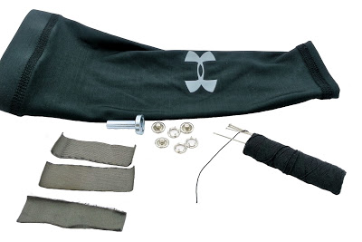
Conductive Fabric Electrode Sleeve
Cut out three rectangular strips of the conductive fabric. Two of the strips should be W 5/8" x L 1 3/4". The third strip should be W 5/8" x L 2".
Take the forearm sleeve, turn it inside out, and put it on the opposite arm that it is intended to go on.
Using fabric pins, pin the two shorter strips on your forearm muscle such that one is in the middle of the muscle body and the other is about an inch apart. Pin the third strip along the back side of your forearm (on the bony part). Check out the pictures to see how to orient the strips.
Carefully take the sleeve off and you're ready to sew.

Slide 29
Conductive Fabric Material
"This medical grade Silver plated 76% Nylon, 24% elastic fiber fabric offers the unique ability to stretch in both directions.
Can be used as an antibacterial wound dressing (note: our material is not sterile) but it also makes a great material for electrode contacts, stretchy hats, socks, gloves, or other garments.
Highly conductive, and conductivity increases as it stretches in one direction, and decreases as it stretches in the other direction.
Silver coating is 99.9% pure. Silver/gray color. “
lessemf.com

Slide 30
S4A Download
http://s4a.cat/

Slide 31
