Slide 1
Balloon Bridges
Josh Weese

Slide 2
Tacoma narrows Bridge

Slide 3
What does the process of building a bridge involve?
We’re going to need…
Specifications
Design
Plan
Materials
Engineering Design Process

Slide 4
Identify the Problem
State the problem in your own words
“How can I make a _____ that will_____?”

Slide 5
Identify Criteria and Constraints
What are the rules?
Limitations
Requirements

Slide 6
Brainstorm Possible Solutions
How can the problem be solved?
Each group member should write down their own solutions
Sketches, notes, etc.

Slide 7
Generate Ideas
Pick a few good ones from the brainstorming session
Develop and refine
Sketches into drawings
Notes into full structured descriptions

Slide 8
Explore Possibilities
Discuss among your team/group
Pros?
Cons?

Slide 9
Select an Approach
Identify a solution that works
Decision may not be unanimous
Support the approach chosen

Slide 10
Build a Model or Prototype
Implement your approach
Model vs. Full scale

Slide 11
Refine the Design
Evaluate your model/prototype
Was it successful?
What went wrong?
Restart the process at “Identify the Problem”

Slide 12
Balloon Bridges!
Objective: Build a bridge with supplied materials between two chairs to hold as much weight as possible
Constraints
Chairs must remain at least two and a half feet apart
Limited to only 15 balloons!
Balloons must remain deflated
When weight is added on the bridge, neither the weight or bridge may touch the floor
If the weight falls off or the bridge breaks, that weight will not count

Slide 13
Balloon Bridges!
Safety: Eye protection must be worn at ALL times
May also need to sit in the chairs as the balloons will try to pull them together
Our prototype will be built with rubber bands!
Full Scale Materials: 15 balloons

Slide 14
Plan and build time….

Slide 15
Reflections
What was the best design and why?
How did your prototype effect your final design?
How did your group make the best out of the materials and time given?
What happened to your bridge as weight was added, removed, and added again?
How did the engineering design process affect the group and the final bridge?

Slide 16
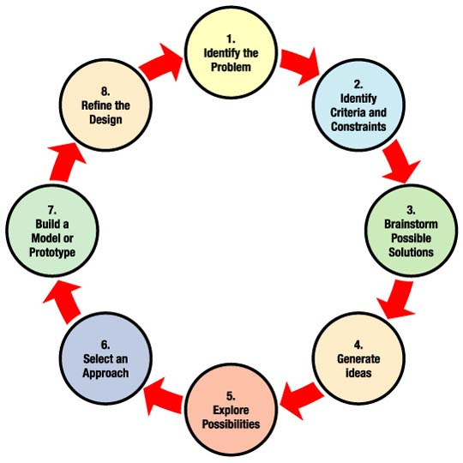
Reflections
[1]

Slide 17
References
Canright, Shelley. Engineering Design Process. NASA. February 22, 2008. http://www.nasa.gov/audience/foreducators/plantgrowth/reference/Eng_Design_5-12.html

