Slide 1
Squishy Circuits
Brian Cain
Kansas State University
INSIGHT GK12

Slide 2
Circuit Basics
Electrons want to flow from positive to negative in a battery
Cannot do this with battery alone
Flow to path of least resistance
Adding conductive elements (like wires) will create a circuit

Slide 3
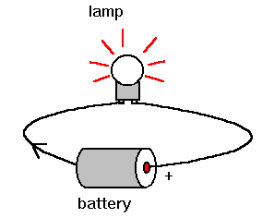
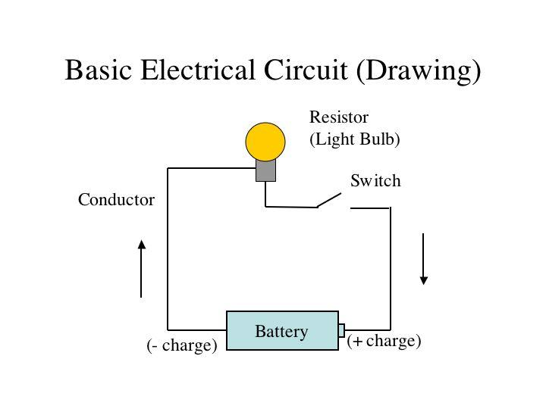
Circuit Basics

Slide 4
Squishy Circuit Basics
What is it?
Check out handout for supplies and how to do this lab at home

Slide 5
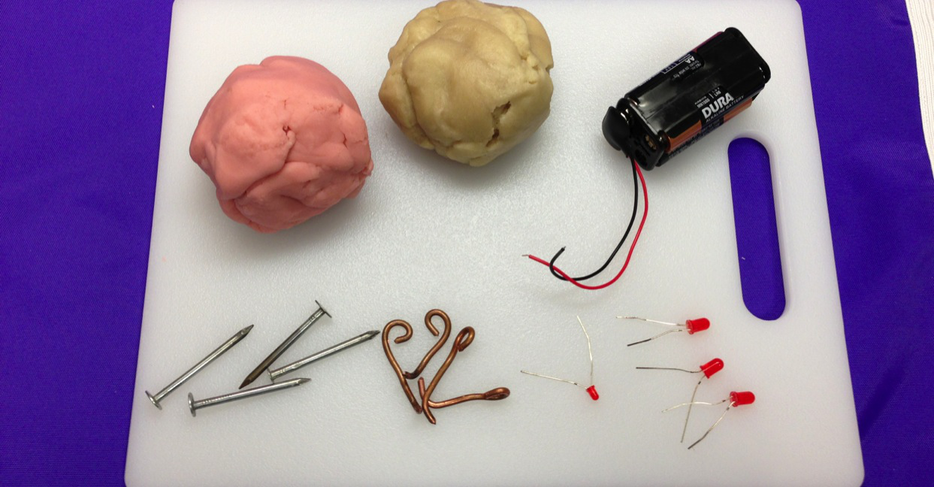
Squishy Circuit Basics: Supplies

Slide 6
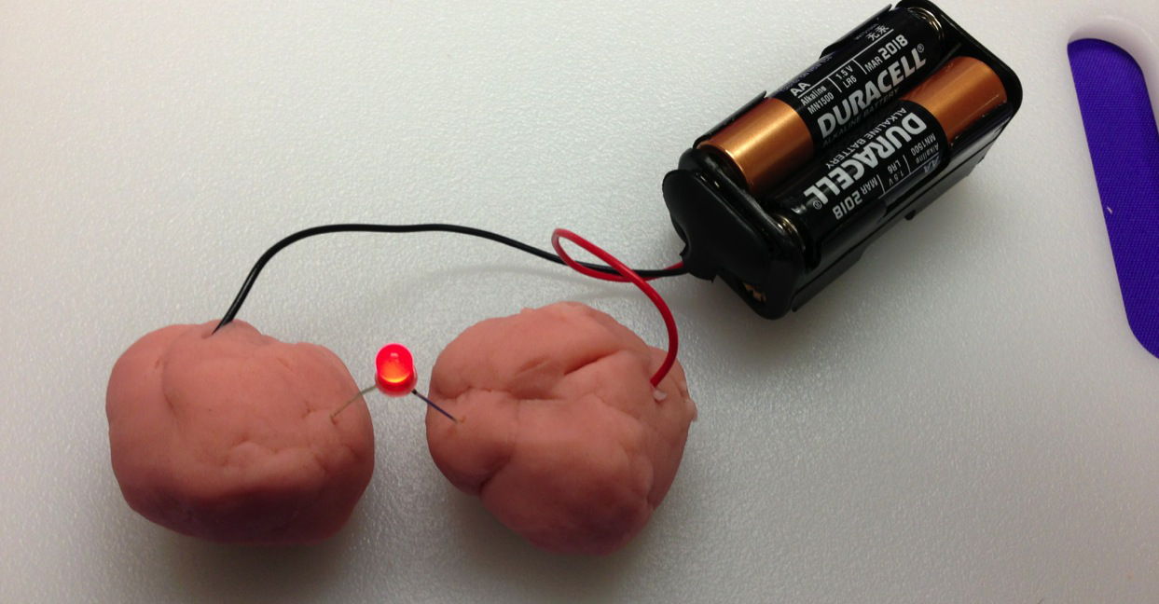
S.C. Basics: A Closed Circuit

Slide 7
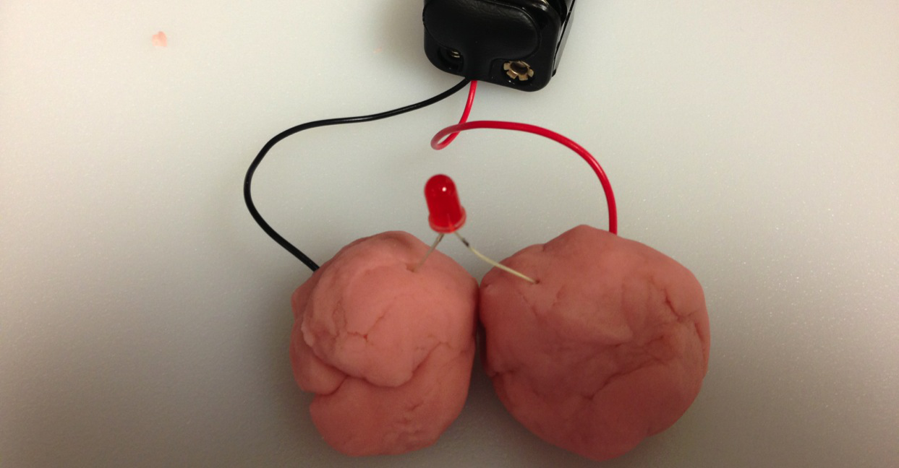
S.C. Basics: A Short Circuit

Slide 8
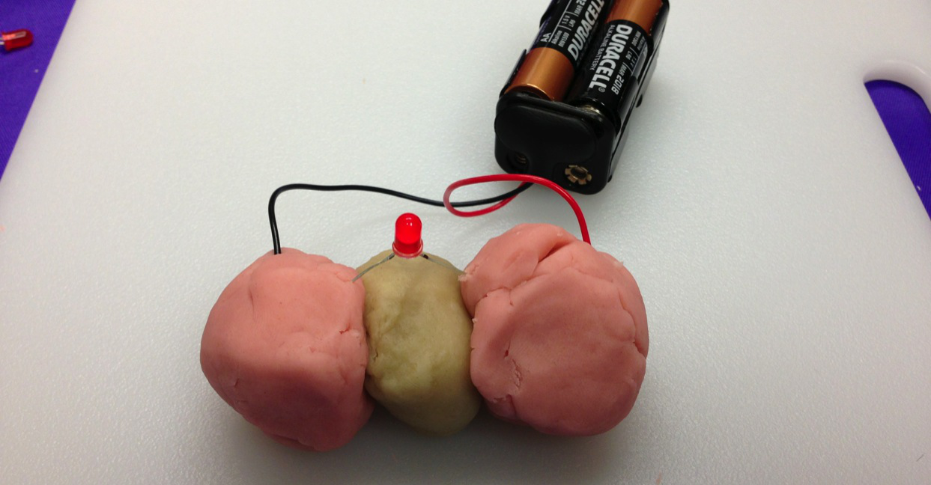
S.C. Basics: Insulating Dough

Slide 9
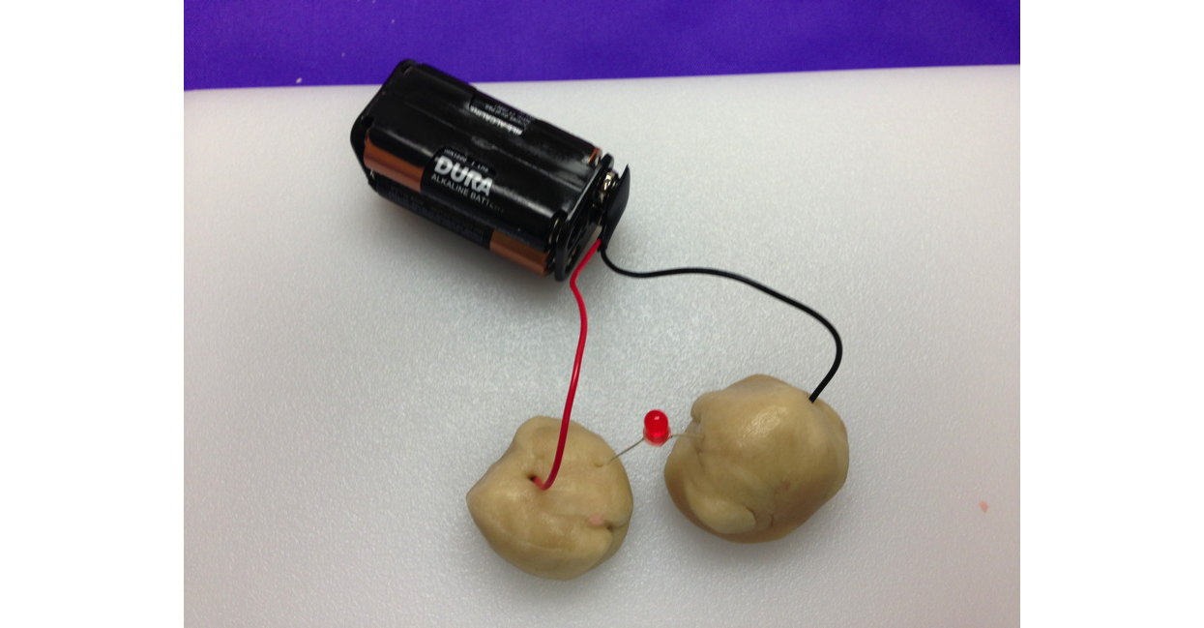
S.C. Basics: Just Insulating Dough

Slide 10
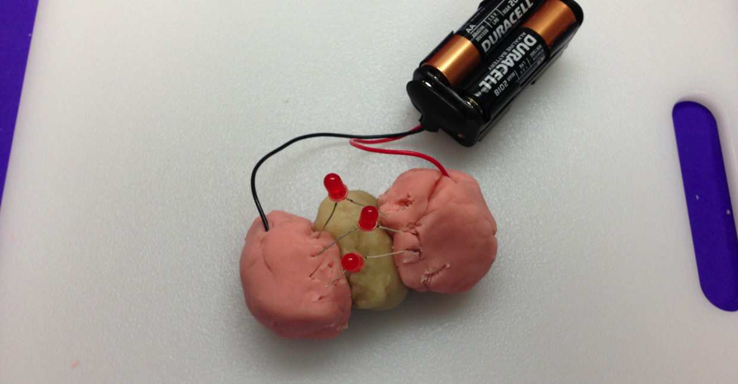
S.C. Basics: A Parallel Circuit

Slide 11
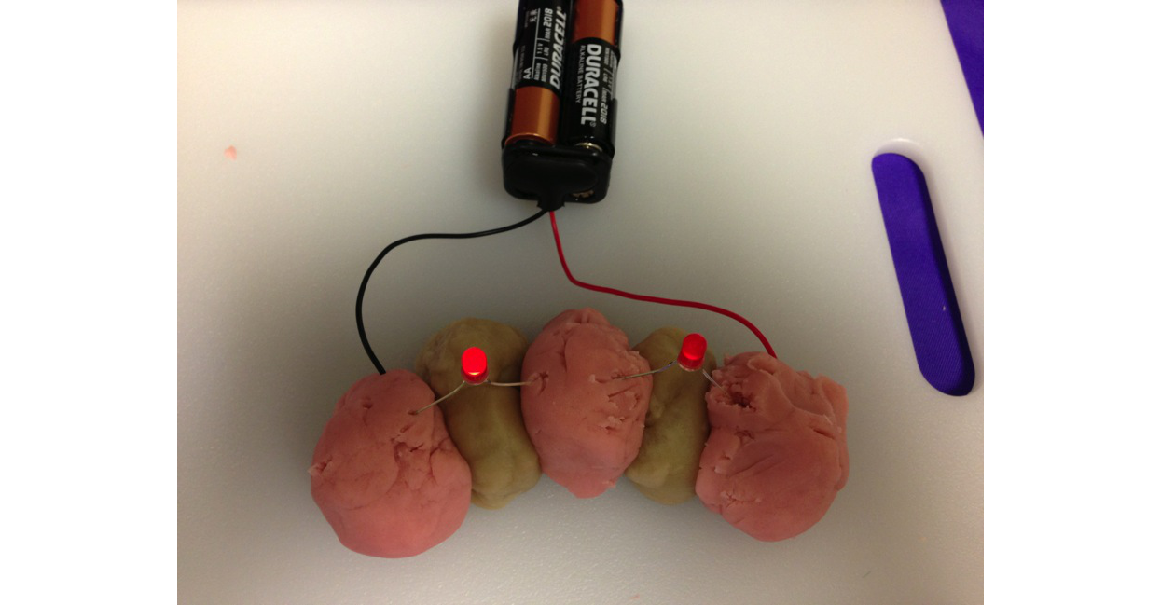
S.C. Basics: A Series Circuit

Slide 12
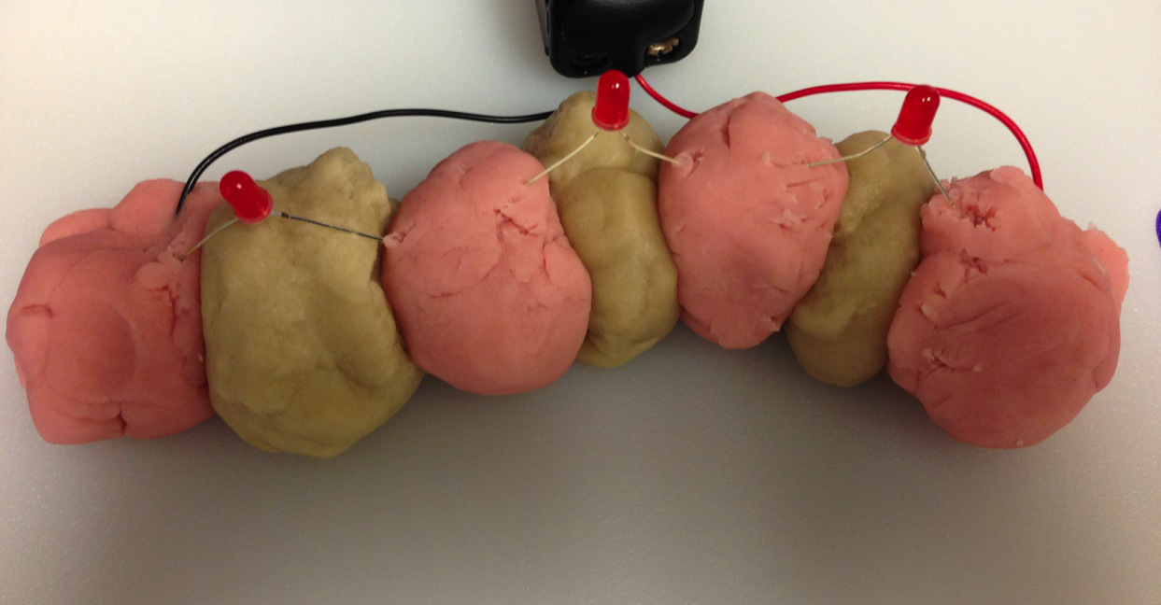
S.C. Basics: A Long Series Circuit

Slide 13
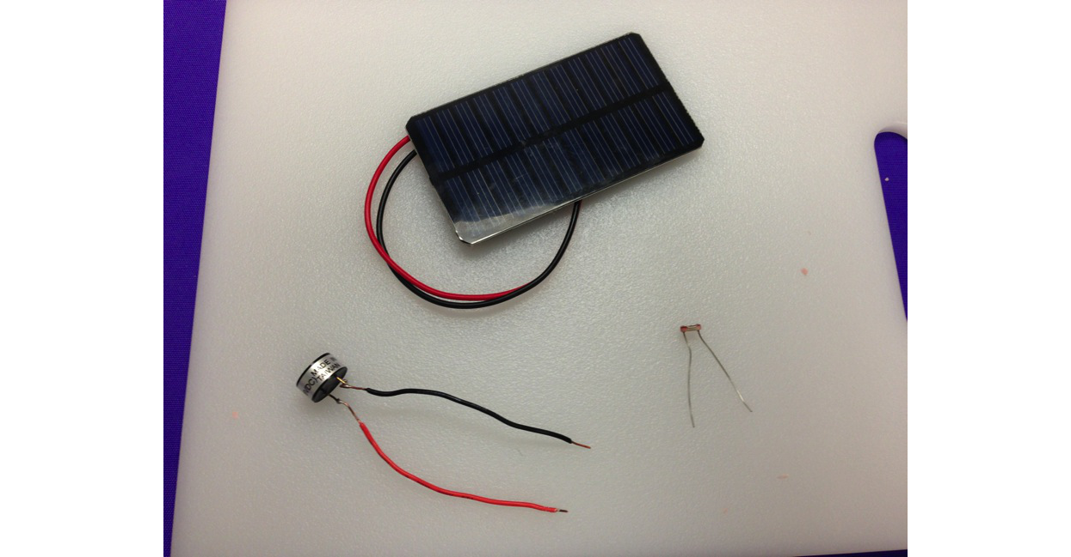
S.C. Basics: Additional Accessories

Slide 14
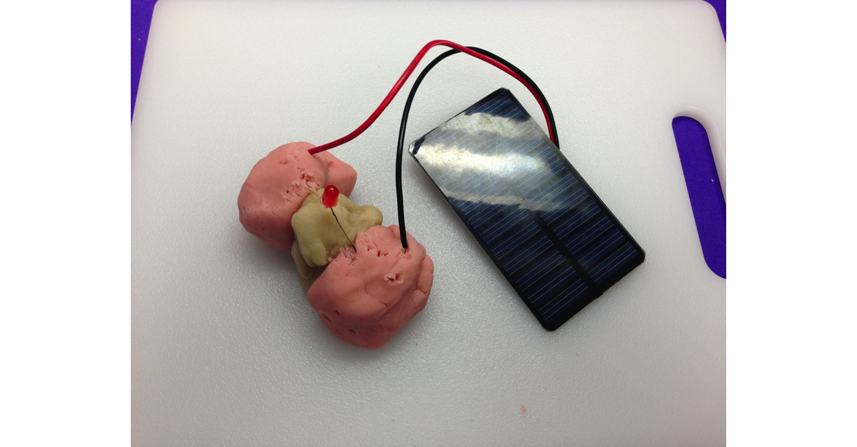
S.C. Basics: Solar Panel

Slide 15
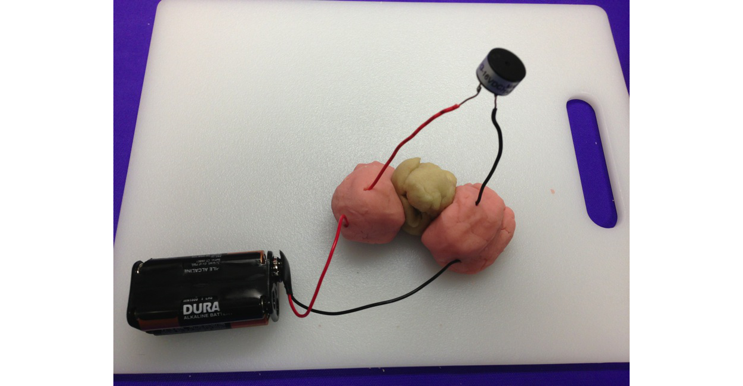
S.C. Basics: Buzzer

Slide 16
Building a Battery
Refer to handout to get started

Slide 17
Special Thanks
Thanks to former GK12 fellow Joseph Lancaster for the photos
http://courseweb.stthomas.edu/apthomas/SquishyCircuits/
Code: The Hidden Language of Computer Hardware and Software book

Slide 18
Questions?

